Slide 1
Mod 1.1: Domain, Range, and End Behavior
Essential Question: How can you determine the domain, range, and end behavior of a function?
CASS: F-IF.5 Relate the domain of a function to its graph and, where applicable, to the quantitative relationship it describes. Also MP.6 Precision
F.IF.4-5.ELT b: Students will analyze graphs and tables that model a context and interpret the meaning of key features (intercepts, symmetry, increasing/decreasing, domain and range) in terms of the context.
F.IF.4-5.ELT c: Students will read about key features (intercepts, symmetry, increasing/decreasing, domain and range) from a verbal description, and then construct graphs about the two quantities based on that information.

Slide 2
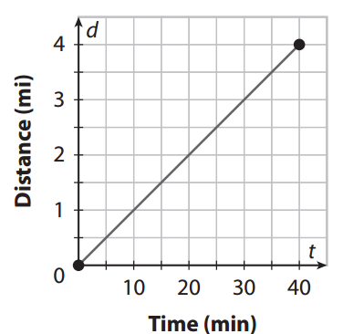
Warm-Up
  Given the graph below, write at least three observations about the two quantities described there and their relationship.

Slide 3
Concept Web: Interval
Intervals
Classify an interval
Infinite interval
Finite interval
Notation
Interval notation
Set notation
Inequality notation

Slide 4
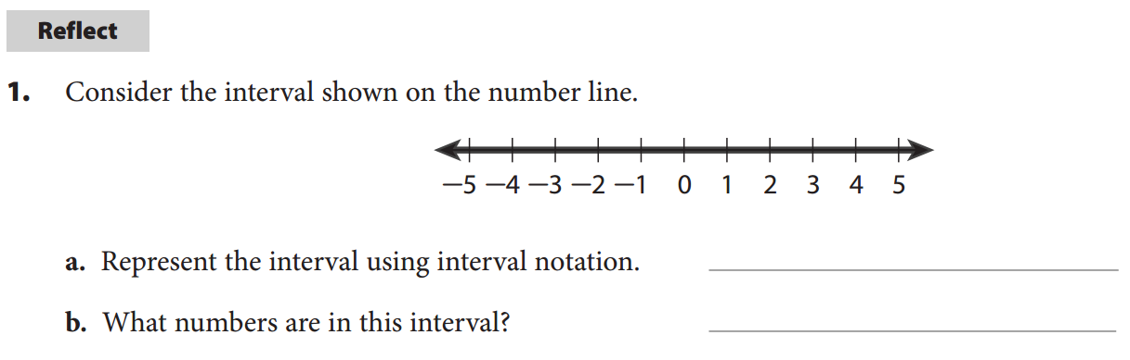
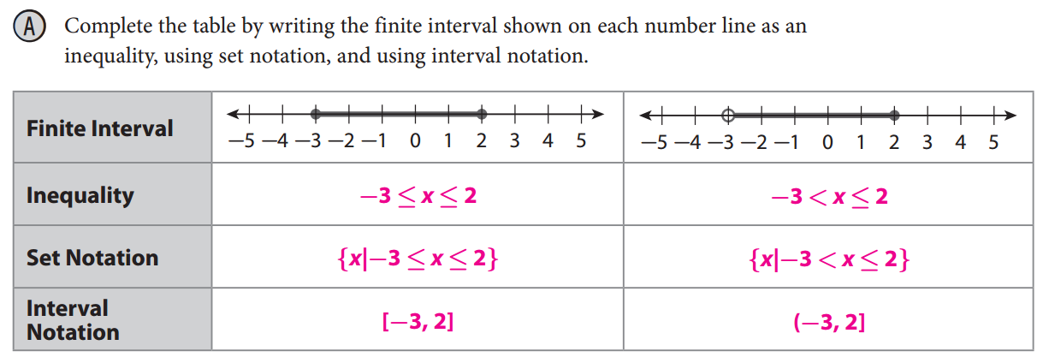

Vocabulary
p. 5
  interval = a part of a number line without any breaks
  A finite interval has two endpoints, which may or may not be included in the interval.
  An infinite interval is unbounded at one or both ends.

Slide 5
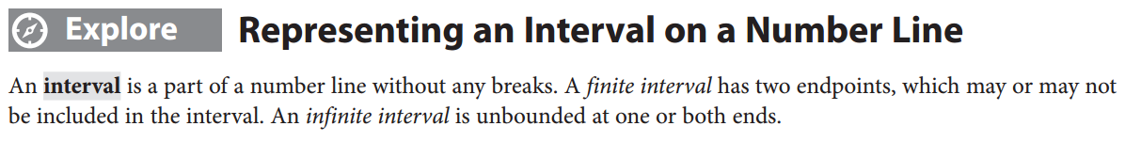
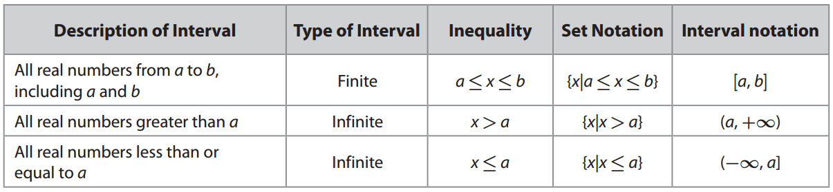
p. 5

Slide 6
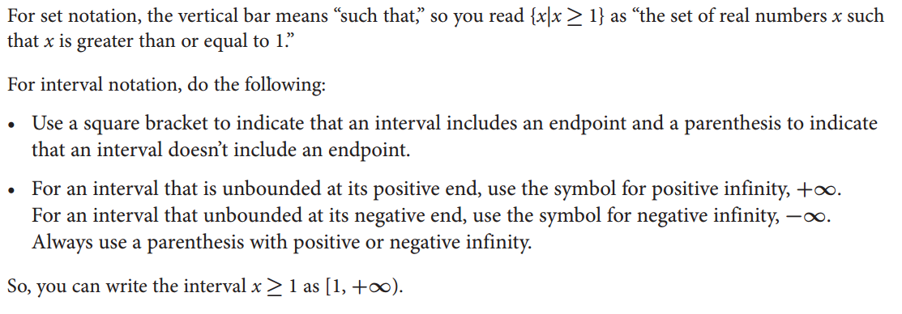
Notation
p. 5

Slide 7
p. 5

Slide 8
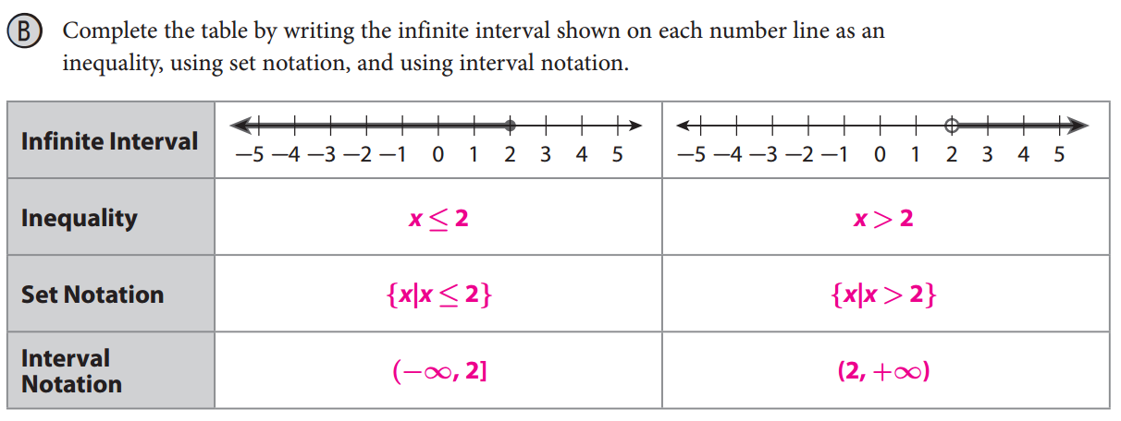
p. 6

Slide 9
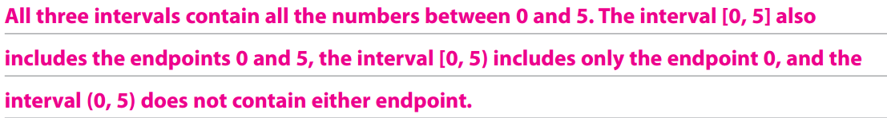

p. 6

Slide 10
Concept Web: Function Attributes
Function Attributes
Domain
End Behavior
Range
(x-values)
(y-values)

Slide 11
Vocabulary (Review from Math I)
p. 6
  Domain of a function = the set of input values, x
  Range of a function = the set of output values, f(x) or y
  The end behavior of a function describes what happens to the ƒ(x)-values as the x-values either:
  increase without bound (approach positive infinity)
  or decrease without bound (approach negative infinity).

Slide 12
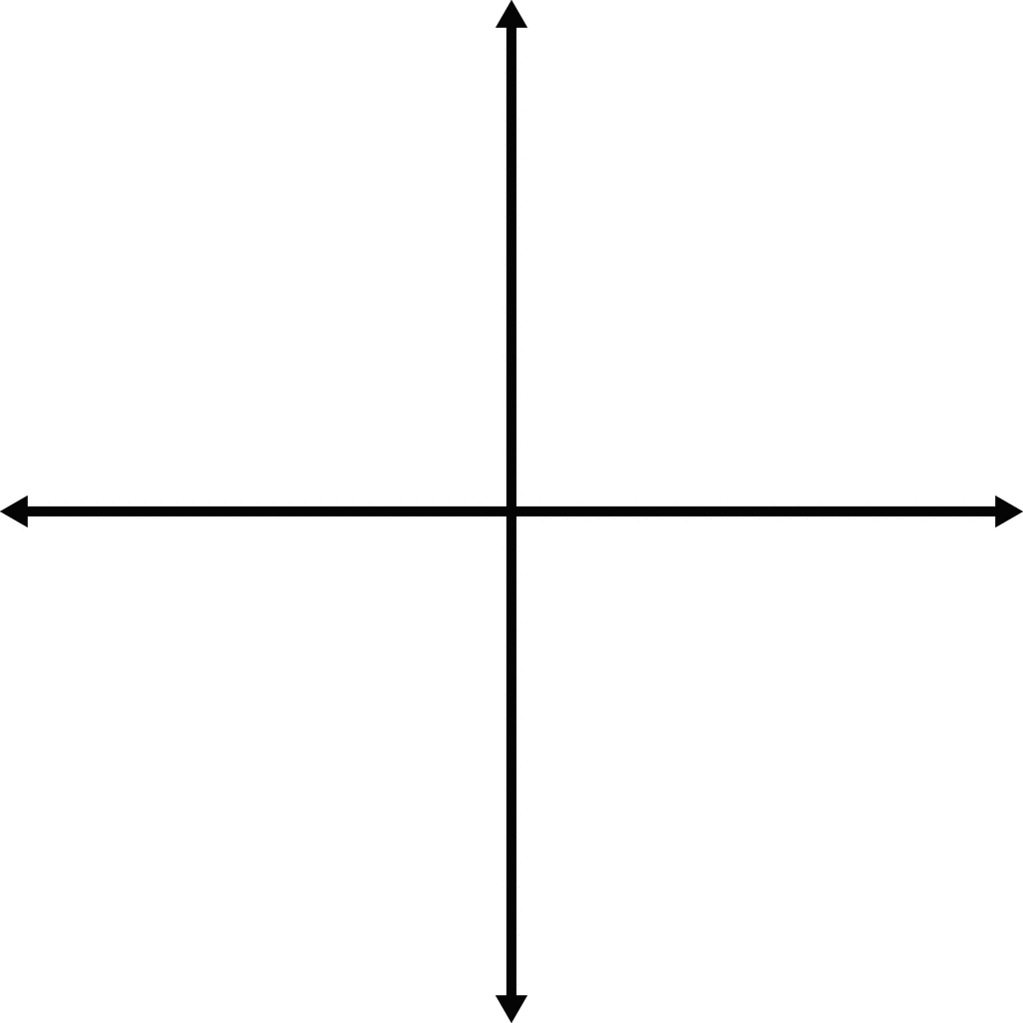
Six End Behavior Options
As x → ∞, y → ∞
As x → ∞, y → 0
As x → ∞, y → −∞
As x → −∞, y → ∞
As x → −∞, y → 0
As x → −∞, y → −∞

Slide 13
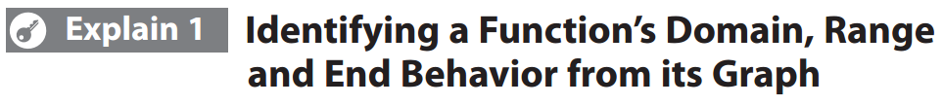
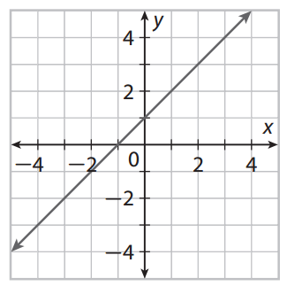
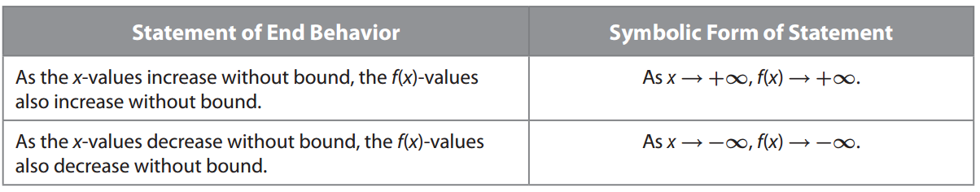
pp. 6-7
From the graph, you can make the following observations:

Slide 14

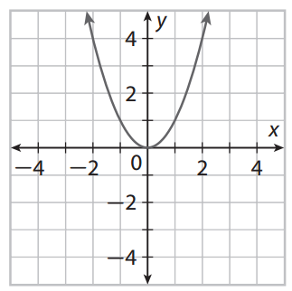















p. 7

Slide 15
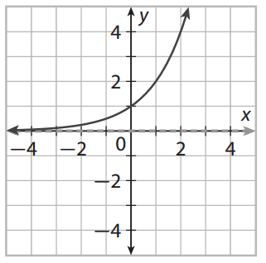
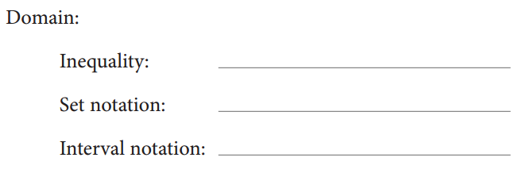



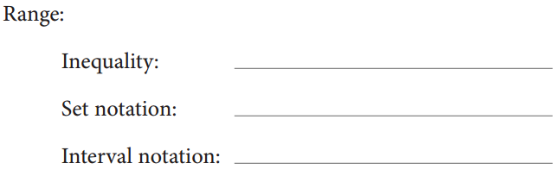
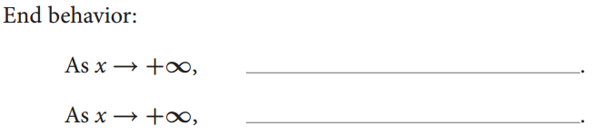





p. 7

Slide 16
p. 8

Slide 17
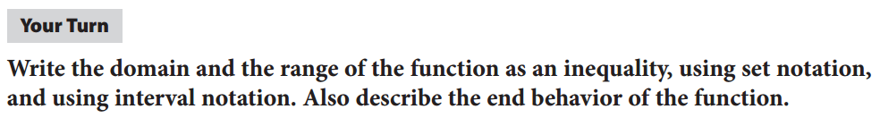
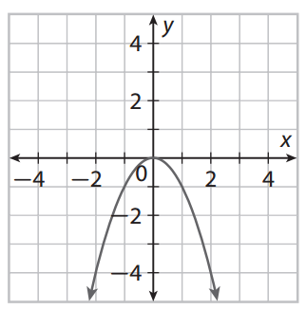
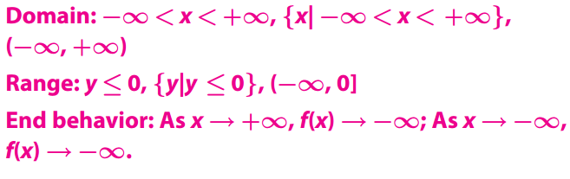
p. 8

Slide 18

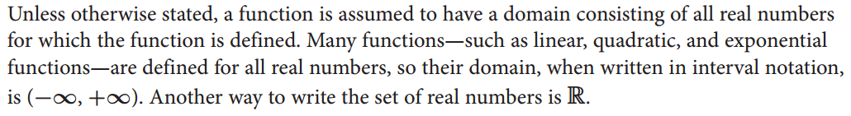
p. 8

Slide 19

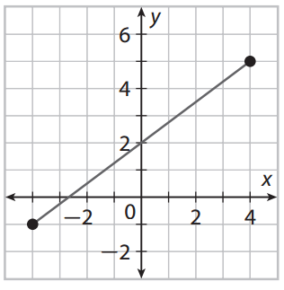
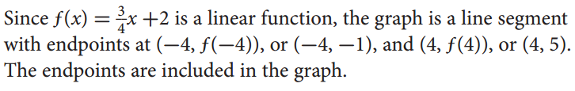


Slide 20

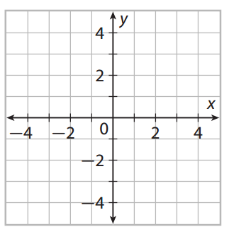
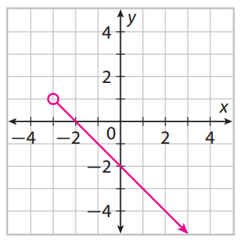
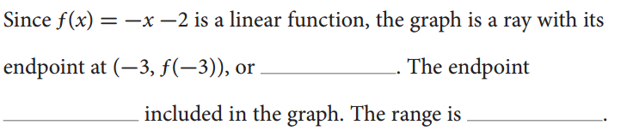




Slide 21


Slide 22
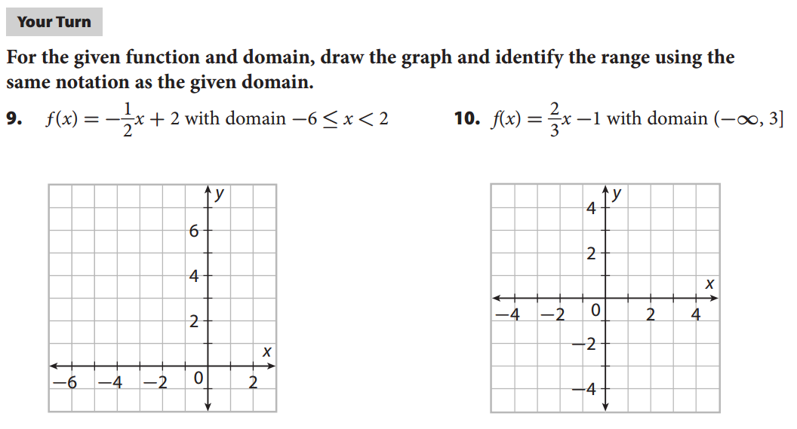
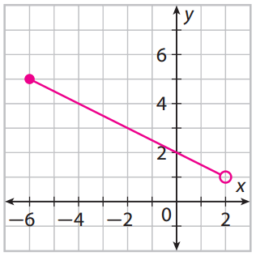
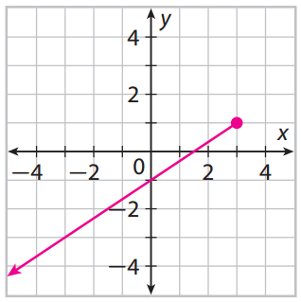



Slide 23
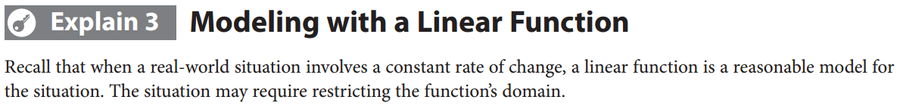
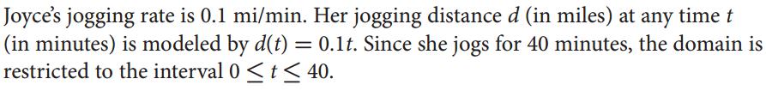


Slide 24
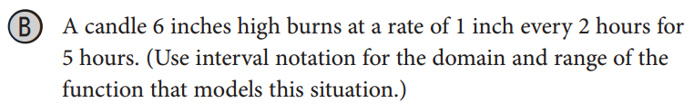
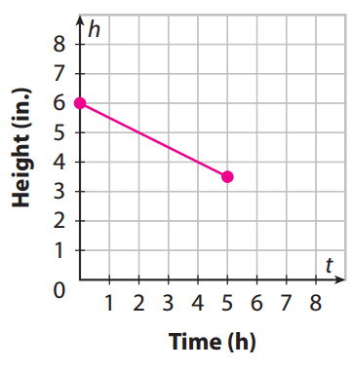
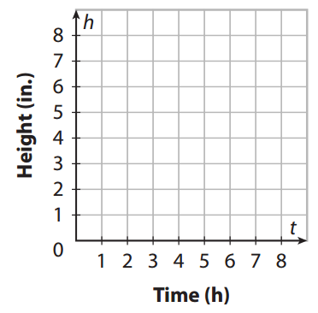

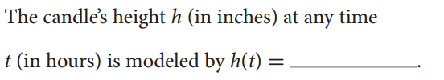

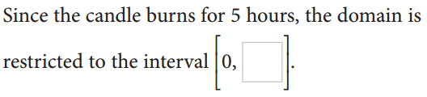



Slide 25
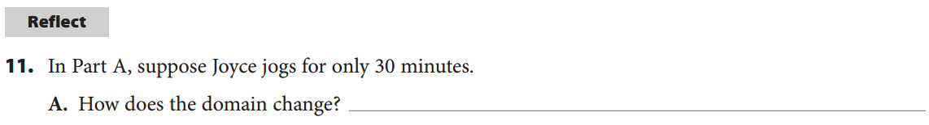



Slide 26
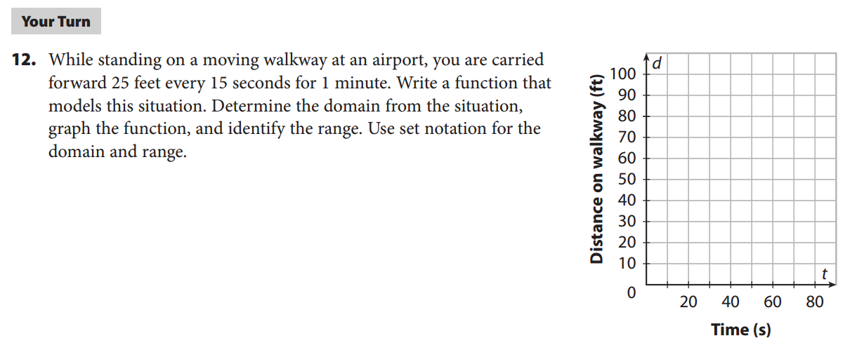
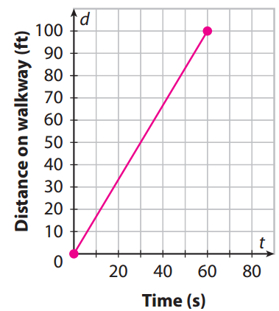
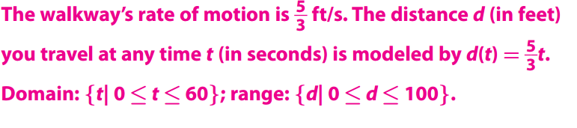

Slide 27
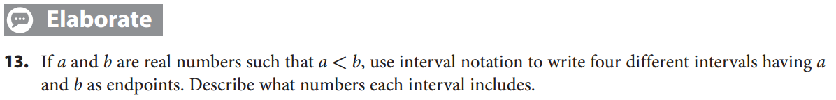
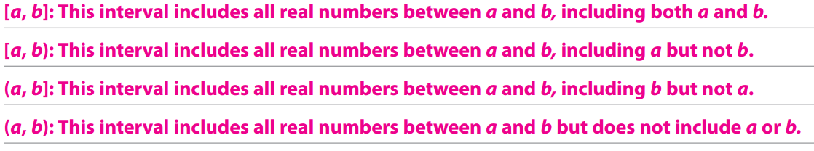
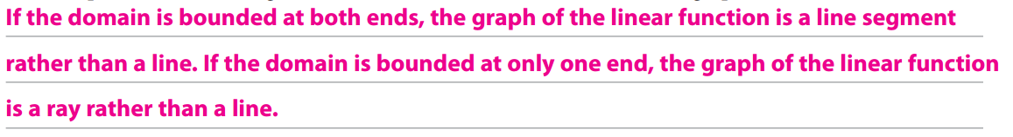

Slide 28
Revisit the Essential Question:
How can you determine the domain, range, and end behavior of a function?
You can determine the range of a function by identifying the x-values for which the function is defined or on which the real-world situation is based.
You can determine the range of a function by identifying the f(x) or y-values that correspond to the range.
You can determine the end behavior of a function by observing what happens to the f(x) or y-values as the x-values increase or decrease toward ±∞.

Slide 29
Problem Set:
pp. 12ff #1-12

