Slide 1
Mod 1.2: Characteristics of Function Graphs
Essential Question: What are some of the attributes of a function, and how are they related to the function’s graph?
CASS: F-IF.4 For a function that models a relationship between two quantities, interpret key features ... and sketch graphs showing key features… Also A-CED.2, A-CED.3
F-IF.6, S-ID.6 MP.7 Using Structure
F.IF.4-5.ELT b: Students will analyze graphs and tables that model a context and interpret the meaning of key features (intercepts, symmetry, increasing/decreasing, domain and range) in terms of the context.
F.IF.4-5.ELT c: Students will read about key features (intercepts, symmetry, increasing/decreasing, domain and range) from a verbal description, and then construct graphs about the two quantities based on that information.

Slide 2
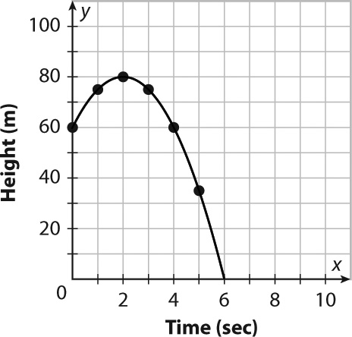
Warm-Up
  Given the graph below, write at least three observations about the two quantities described there and their relationship.

Slide 3
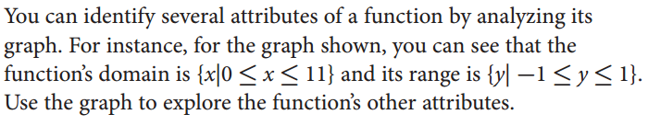
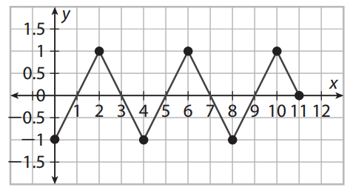

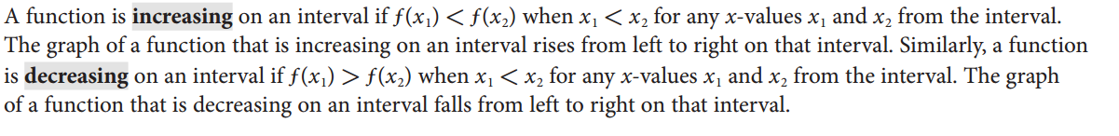
EXPLORE
p. 17

Slide 4
EXPLORE
p. 17

Slide 5
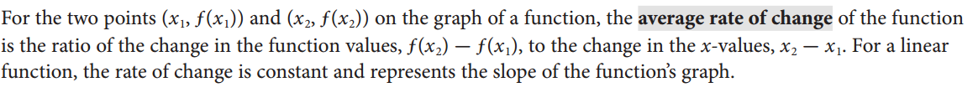
EXPLORE
p. 17

Slide 6
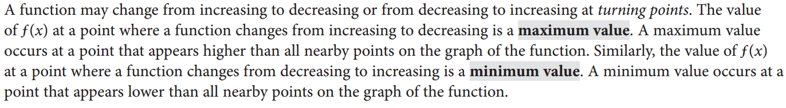




EXPLORE
pp. 17-18

Slide 7



EXPLORE
p. 18

Slide 8
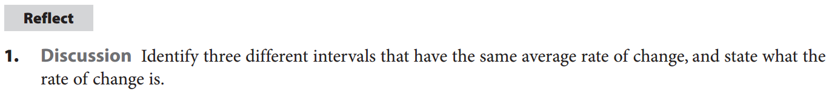
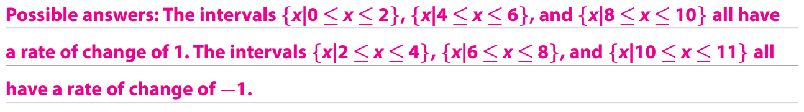
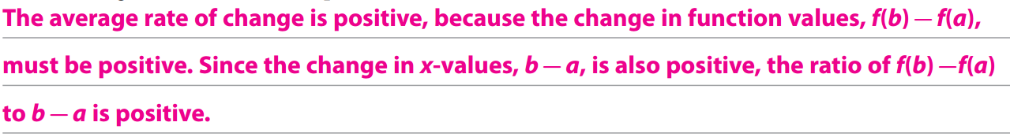
REFLECT

Slide 9
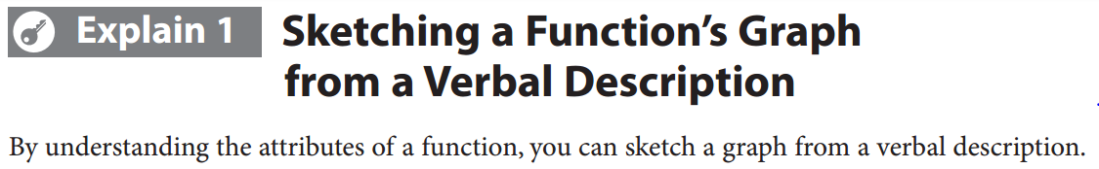
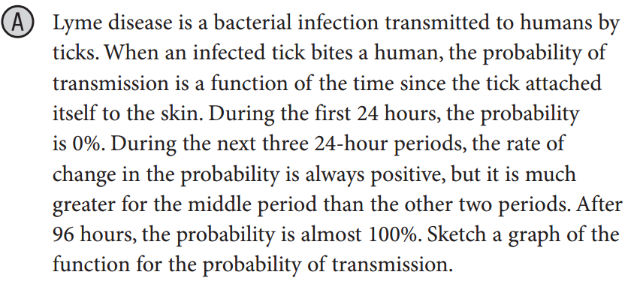
EXPLAIN 1
EXAMPLE 1A

Slide 10
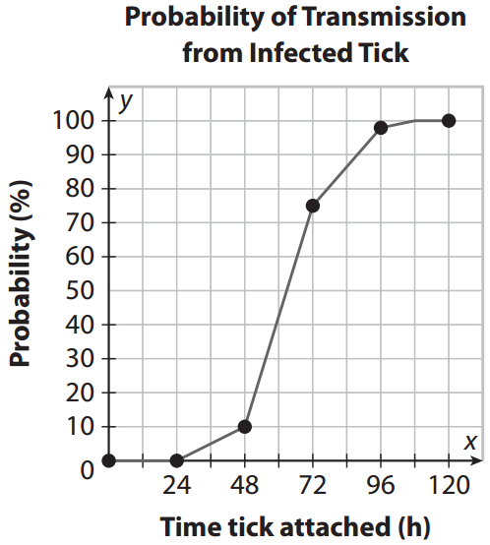
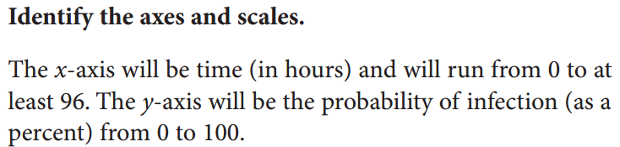
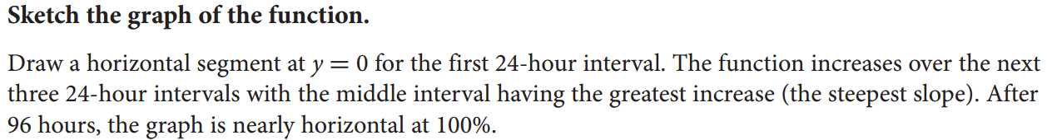

Slide 11
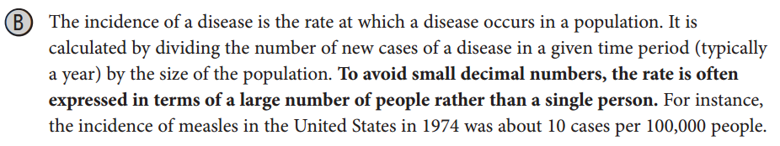
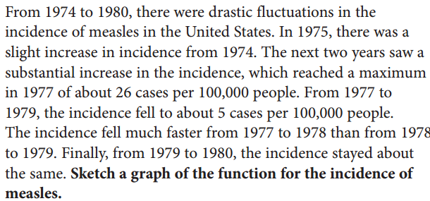
EXAMPLE 1B

Slide 12
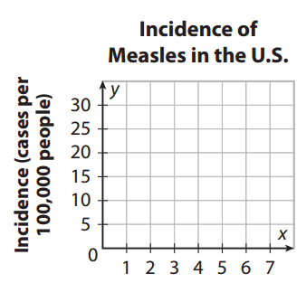
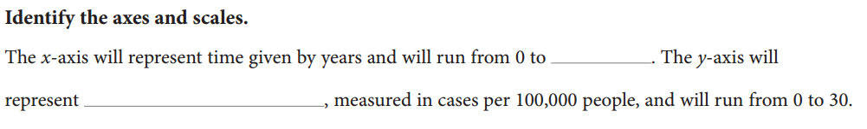




Slide 13


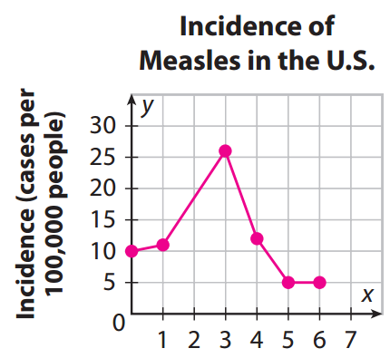

Slide 14
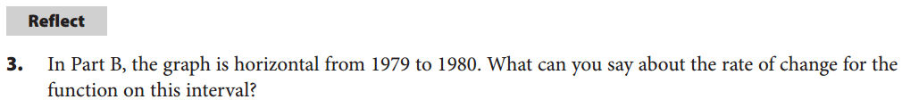
REFLECT

Slide 15
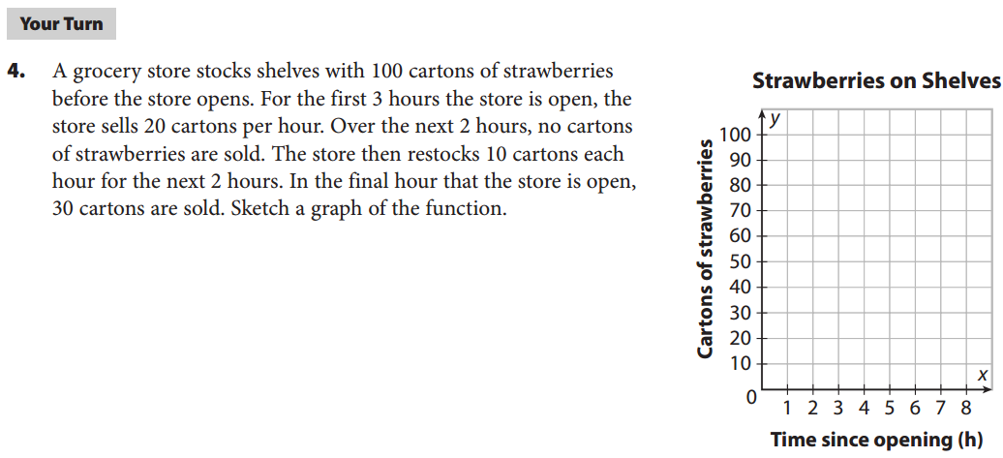
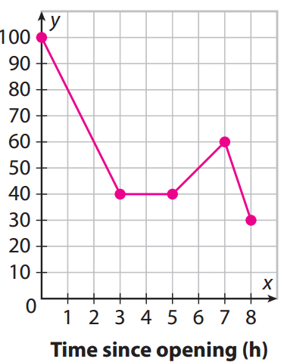
Your Turn
p. 18

Slide 16
Pause for Worksheet 1.2

Slide 17
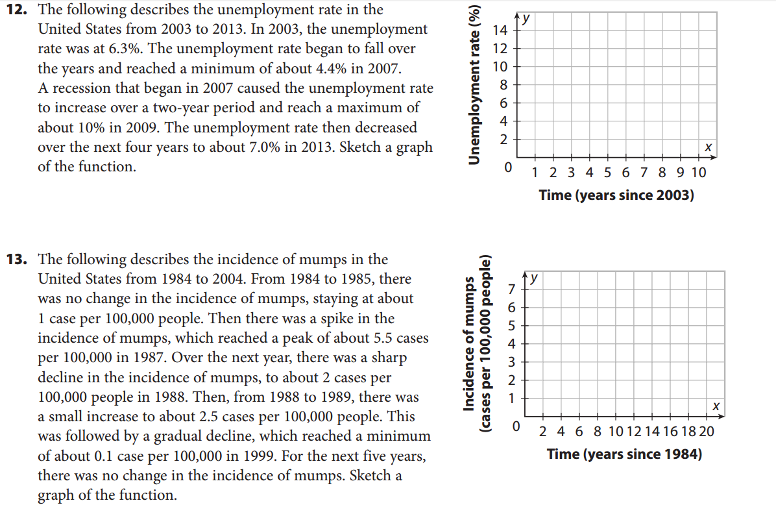
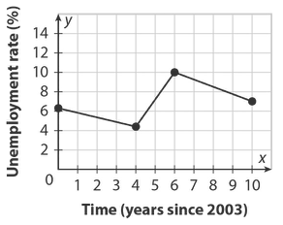
We do
p. 26, #12

Slide 18
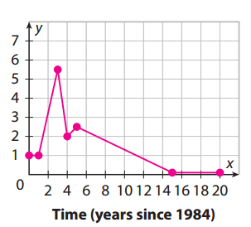
You do together
p. 26, #13

Slide 19
Assignments
pp. 24ff #1-13
WS 1.2

