Slide 1

Click here

Slide 2
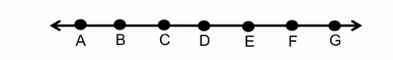
Warm-up
Jethro says there are six segments and two rays. What do you see?
How many different segments can you name?
How many different lines can you name?
How many different rays can you name?

Slide 3
Mod 14.1:
Angles Formed by Intersecting Lines
Essential Question: How can you find the measures of angles formed by intersecting lines?
CASS: G-CO.9 Proving theorems about lines and angles.
MP.3 Logic

Slide 4
Angles are classified as acute, right, obtuse, or straight.
A
A
Acute angle
Right angle
A
A
Obtuse angle
Straight angle

Slide 5
Angle Pair Relationships
vertical angles have the same measure
1 and 3 are vertical angles.
1
4
2
2 and 4 are vertical angles.
3
linear pair angles add up to 180°
5
6
5 and 6 are a linear pair.

Slide 6
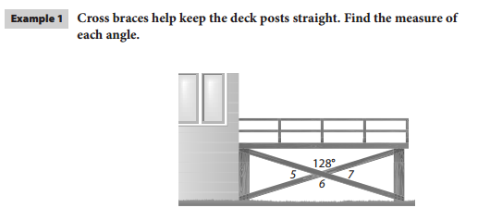

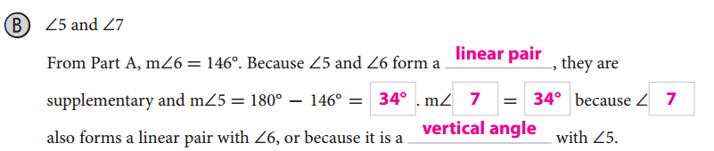
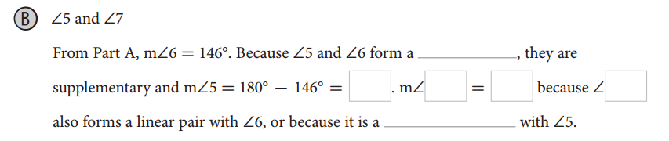
EXPLAIN 1
Using Vertical Angles

Slide 7



Your Turn
Finding Angle Measures
6. The measures of two vertical angles are 58° and (3x + 4)°. Find the value of x.
$$3x+4=58$$
$$3x=54$$
$$x=18$$

Slide 8



Your Turn
7. The measures of two vertical angles are given by the expressions (x + 3)° and (2x − 7)°.
Find the value of x.
What is the measure of each angle?
$$x+3=2x−7$$
$$10=x$$
$$x+3=10+3=13$$
So both angles have a measure of 13°.

Slide 9
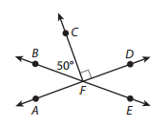
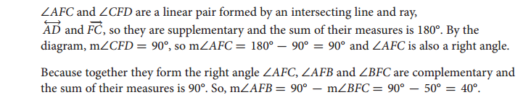
EXPLAIN 2
Use the diagram below to find the missing angle measures. Explain your reasoning.

Slide 10
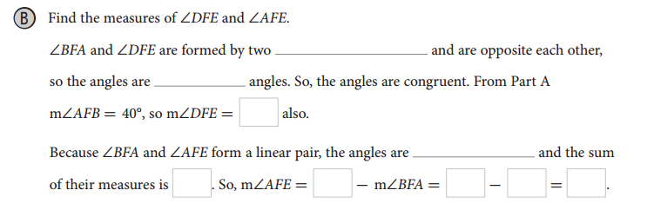
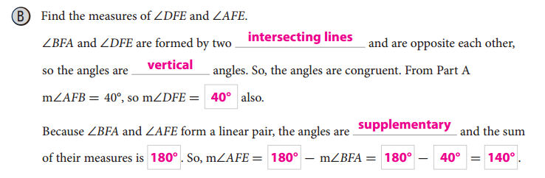
EXPLAIN 2
Use the diagram below to find the missing angle measures. Explain your reasoning.

Slide 11
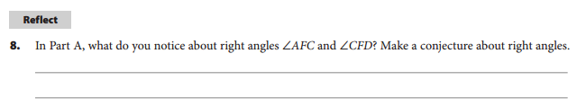
EXPLAIN 2
Use the diagram below to find the missing angle measures. Explain your reasoning.

Slide 12
Two angles are complementary angles (or complements) if the sum of their measures is 90°
3
1
4
2
complementary
complementary
adjacent
nonadjacent
Two angles are supplementary angles (or supplements) if the sum of their measures is 180°
8
7
5
6
supplementary
supplementary
adjacent
nonadjacent

Slide 13
You can represent the measures of an angle and its complement as x° and (90 − x)°.
(90-x)
x
x
(90-x)
complementary
complementary
adjacent
nonadjacent
Similarly, you can represent the measures of an angle and its supplement as x° and (180 − x)°.
x
(180-x)
x
(180-x)
supplementary
supplementary
adjacent
nonadjacent

Slide 14

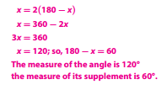
Your Turn
Finding Measures of Complements & Supplements
9. The measure of an angle is equal to the measure of its complement.
10. The measure of an angle is twice the measure of its supplement.

Slide 15

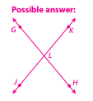
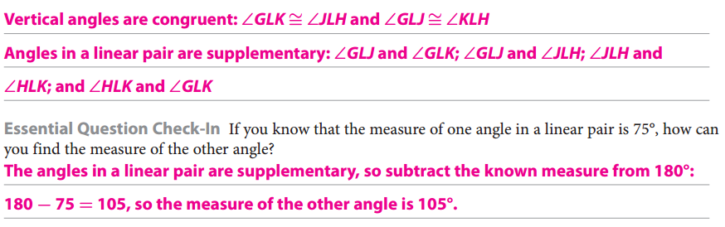
ELABORATE

Slide 16
ASSIGNMENTS
pp. 683f #1-5
WS 14.1 AB
Return completed receipt for syllabus
Key Content:
Linear Pair
Vertical Angles
Vertical Angles Theorem
Complementary Angle
Supplementary Angle

Slide 17
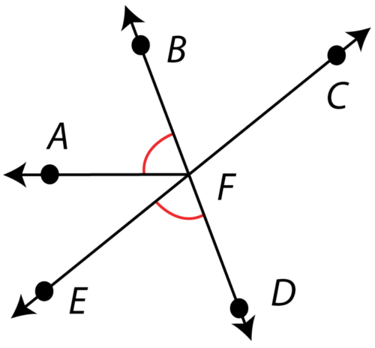
TICKET-OUT-THE-DOOR
Given: m∠AFB = m∠EFD = 65°
Find measure of all angles.

