Slide 1
Mod 15.1:
Interior and Exterior Angles
Essential Question: What can you say about the interior and exterior angles of a triangle and other polygons?
CASS: G-CO.10 Prove theorems about triangles. MP.8 Patterns

Slide 2
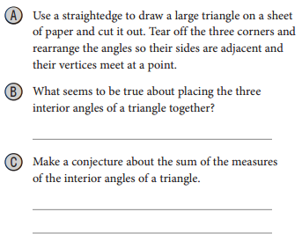
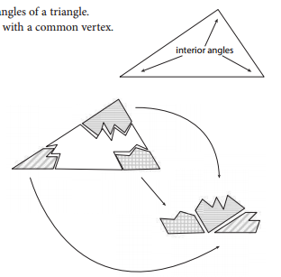
EXPLORE 1
Exploring Interior Angles in TrianglesPLORE 1

Slide 3
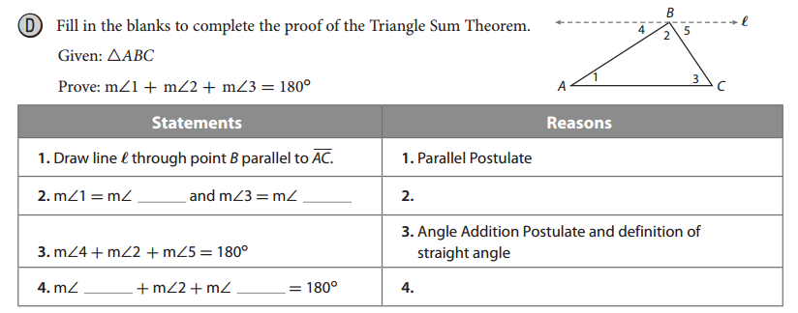
EXPLORE 1
4
5
Alternate Interior Angles Theorem
1
3
Substitution Property of Equality

Slide 4
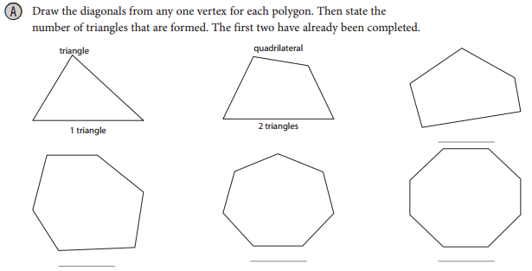
EXPLORE 2
Exploring Interior Angles in Polygons1

Slide 5
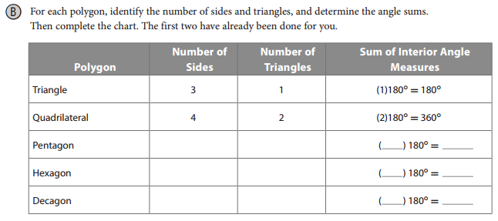
EXPLORE 2
Exploring Interior Angles in Polygons1

Slide 6

EXPLORE 2
Exploring Interior Angles in Polygons1
Reflect

Slide 7
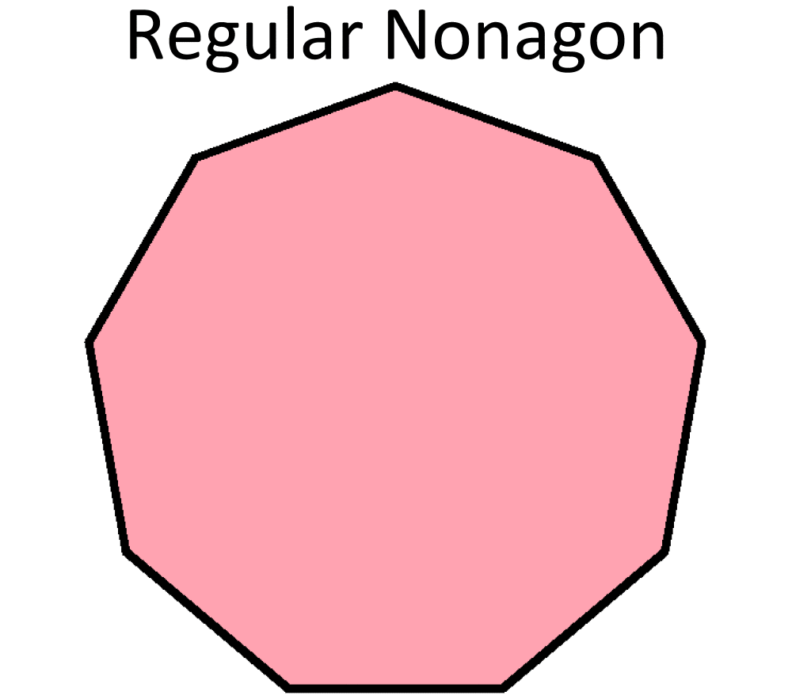
Polygon Angle Sum Theorem
The sum of the measures of the interior angles of a convex polygon with n sides is
EXPLAIN 1
Given a nonagon, find the sum of measures of its interior angles. Then find the measure of each angle.
So the total of the interior angle measures is 1260⁰. Each angle measures 140⁰.

Slide 8
Polygon Angle Sum Theorem
Your Turn: On WS 15.1, complete # 1-8c
1260º; 140º
540º; 108º
1800º; 150º
900º; 128.6º
360º; 90º
2520º; 157.5º
1440º; 144º
720º; 120º
78º
26º
86º
154º
6
9
6
11
100º
65º
8b) 6 sides
8c) 52 sides

Slide 9
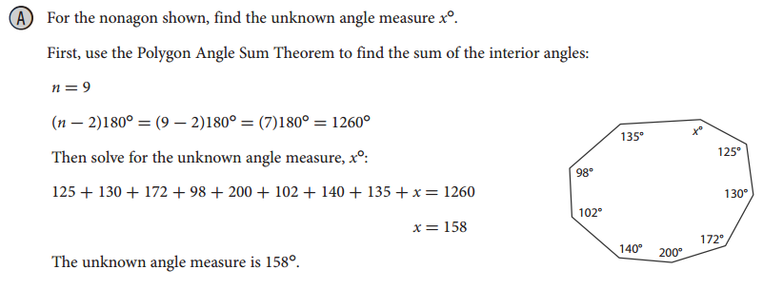
EXAMPLE 1A

Slide 10
EXAMPLE 1B

Slide 11
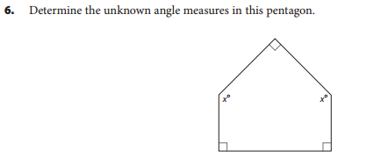
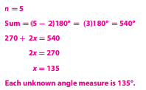
Your Turn
Exploring Interior Angles in Polygons1

Slide 12


Your Turn
Exploring Interior Angles in Polygons1
n = 6
Sum = (6 - 2)180° = (4)180° = 720°
b + 2b + 69 + 108 + 135 + 204 = 720
b = 68
2b = 136
The two unknown angle measures are 68° and 136°.
n = 4
Sum = (4 - 2)180° = 2(180°) = 360°
89 + 80 + 104 + x = 360
x = 87
The unknown angle measure is 87°.

Slide 13
EXPLAIN 2
B
50 + 70 + x = 180
70º
50º
120 + x = 180
(x)º
A
C
(y)º
x = 60
exterior angles
x + y = 180
60 + y = 180
y = 120

Slide 14
Exterior Angle Theorem
The measure of an exterior angle of a triangle is equal to the sum of the measures of its remote interior angles.
B
2
1
3
A
C
1 + 2 = 3

Slide 15
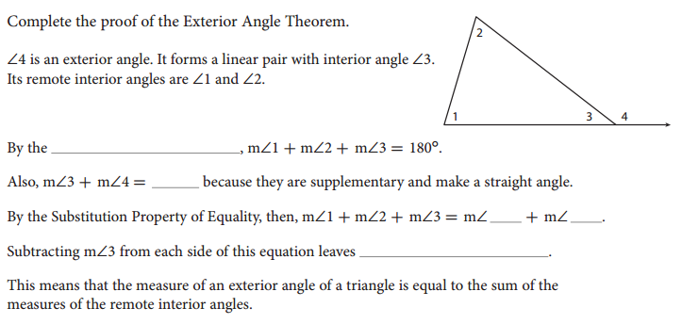
EXAMPLE 2
Triangle Sum Theorem
180˚
3
4
m∠ 1 + m∠ 2 = m∠ 4

Slide 16
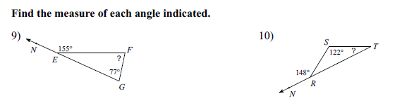
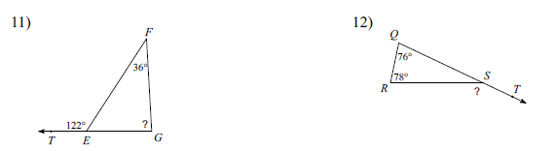
Exterior Angle Theorem
Your Turn: WS 15.1 problems # 9 - 12
Answers: 9) 78° 10) 26° 11) 86° 12) 154°

Slide 17
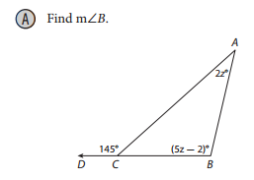
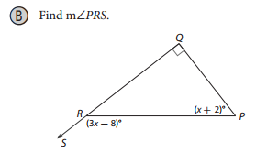
EXAMPLE 3
145 = 2z + 5z - 2
145 = 7z - 2
z = 21
x = 50
m∠PRS = 142°
m∠B = (5z - 2)°
= (5(21) - 2)°
= (105 - 2)°
= 103°

Slide 18
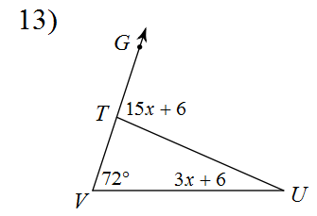
EXPLAIN 3
15x + 6 = 72 + (3x + 6)
15x + 6 = 78 + 3x
–3x – 6 – 6 – 3x
12x = 72
12 12
x = 6

Slide 19
Exterior Angle Theorem
Your Turn: WS 15.1 complete # 13 - 18
6
9
6
11
100º
65º

