Slide 1
Mod 15.2:
Isosceles and Equilateral Triangles
Essential Question: What are the special relationships among angles and sides in isosceles and equilateral triangles?
CASS: G-CO.10 Prove theorems about triangles. MP.3 Logic

Slide 2
EXPLORE 1
Anatomy of Isosceles Triangles
Isosceles triangle =
A
a triangle with at least two congruent sides.
vertex angle
leg
leg
base angles
B
C
base
Given is isosceles, what can we state about

Slide 3
EXPLAIN 1
p. 740
Isosceles Triangle Theorem
(aka Base Angles Theorem)
If two sides of a triangle are congruent, then the angles opposite them are congruent.
B
A
C
If , then .

Slide 4
EXPLAIN 1
p. 740
Converse of the Isosceles Triangle Theorem
(aka Base Angles Converse Theorem)
If two angles of a triangle are congruent, then the sides opposite them are congruent.
B
A
C
If , then .

Slide 5
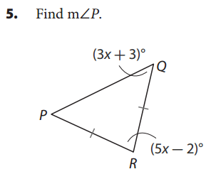

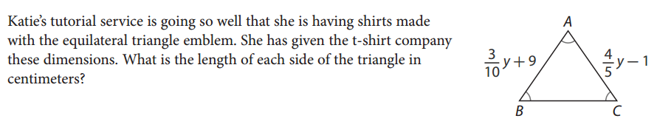
EXAMPLE 3
p. 744
3x + 3 + 3x + 3 + 5x – 2 = 180
11x + 4 = 180
11x = 176
x = 16
m∠P = (3x - 3)°
= [3(16) – 3]°
= (48 – 3)°
= 45°
So the length of each side of the triangle is 15 cm.

