Slide 1
Mod 15.3:
Triangle Inequalities
Essential Question: How can you use inequalities to describe the relationships among side lengths and angle measures in a triangle?
CASS: G-SRT.5 Use congruence ... criteria for triangles to solve problems and to prove relationships in geometric figures., G-GMD.6 Verify experimentally that in a triangle, angles opposite longer sides are larger, sides opposite larger angles are longer, and the sum of any two side lengths is greater than the remaining side length; apply these relationships to solve real-world and mathematical problems. Also G-CO.10, G-CO.12 MP.5 Using Tools

Slide 2
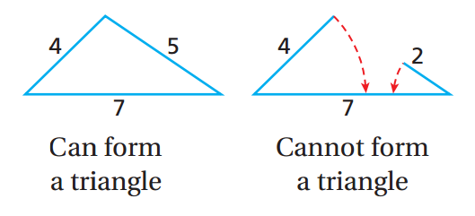
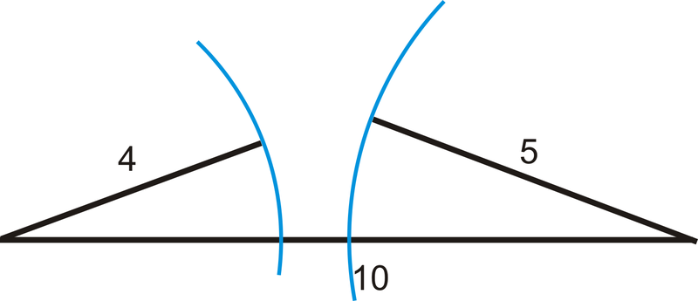
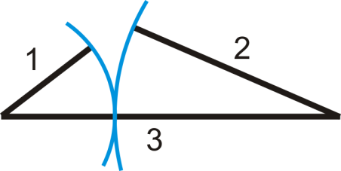
EXPLORE

Slide 3
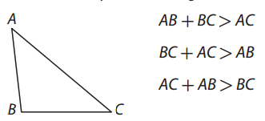
EXPLAIN 1
Triangle Inequality Theorem
The sum of any two side lengths of a triangle is greater than the third side length.
To be able to form a triangle, each of the three inequalities must be true. So, given three side lengths, you can test to determine if they can be used as segments to form a triangle. To show that three lengths cannot be the side lengths of a triangle, you only need to show that one of the three triangle inequalities is false.

Slide 4
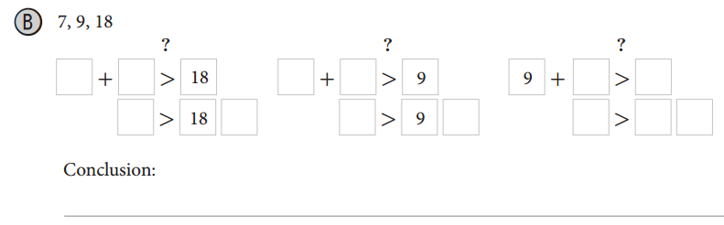
EXAMPLE 1B p. 755

Slide 5
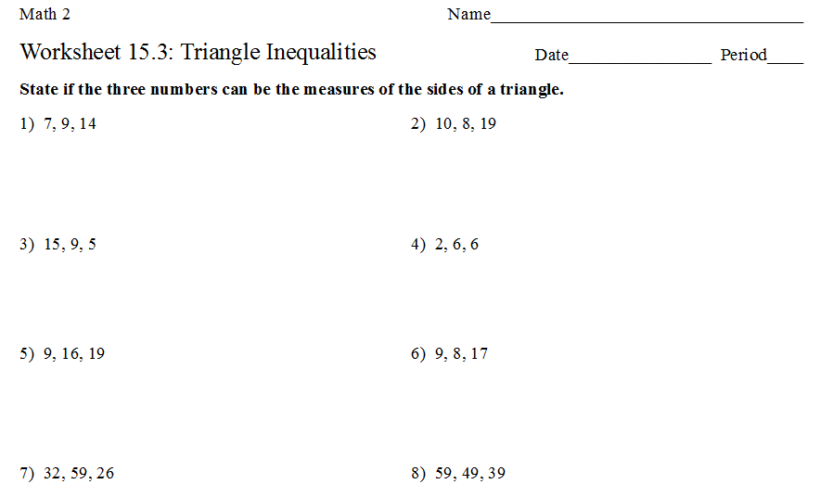
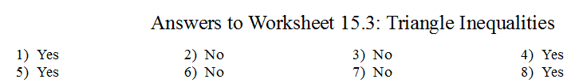
PRACTICE
WS 15.3A complete #1 – 8.

Slide 6
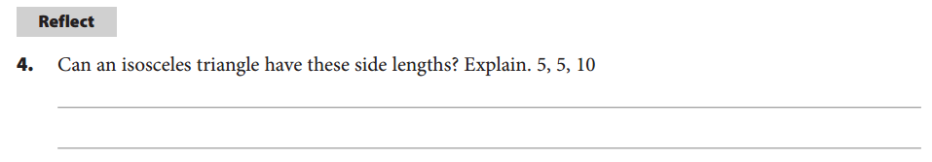
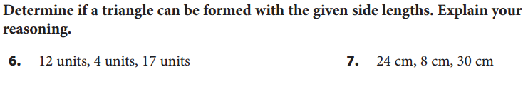
Your Turn
Using the Triangle Inequality Theorem

Slide 7
EXPLAIN 2
Finding Possible Side Lengths in a Triangle
From the Explore, you have seen that if given two side lengths for a triangle, there are an infinite number of side lengths available for the third side. But the third side is also restricted to values determined by the Triangle Inequality Theorem.

Slide 8
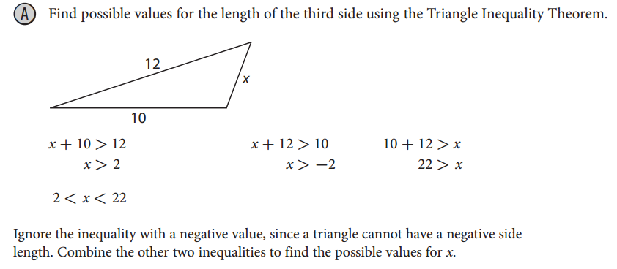
EXAMPLE 2
Finding Possible Side Lengths in a Triangle

Slide 9
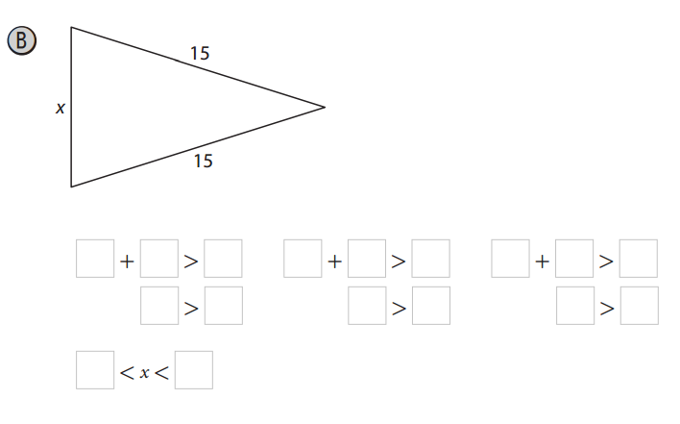
EXAMPLE 2
Finding Possible Side Lengths in a Triangle

Slide 10
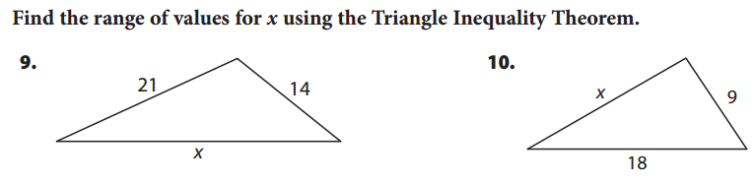
Your Turn

Slide 11
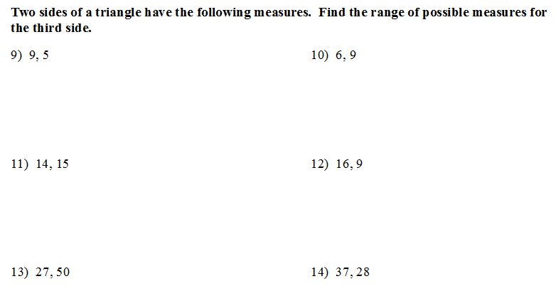
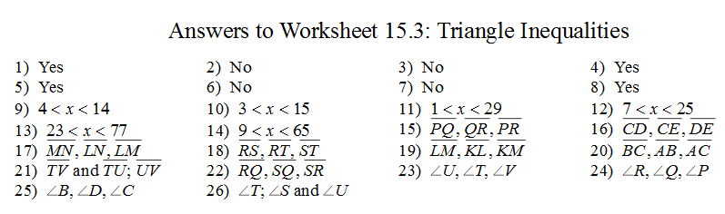
PRACTICE
WS 15.3A complete #9 – 14.

Slide 12
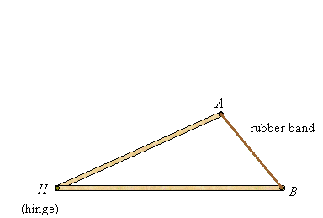
EXPLAIN 3
Ordering a Triangle’s Angle Measures Given
Its Side Lengths
From the Explore, you saw how changing an angle had an effect on the opposite side length. This is formulated as Side-Angle Relationships in Triangles.

Slide 13
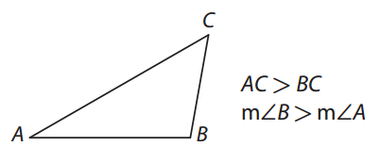
EXPLAIN 3
Side-Angle Relationships in Triangles
If two sides of a triangle are not congruent, then the larger angle is opposite the longer side.

Slide 14
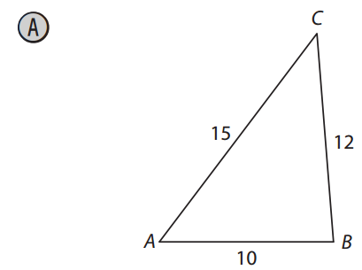
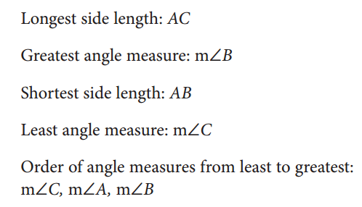
EXAMPLE 3A p. 758

Slide 15
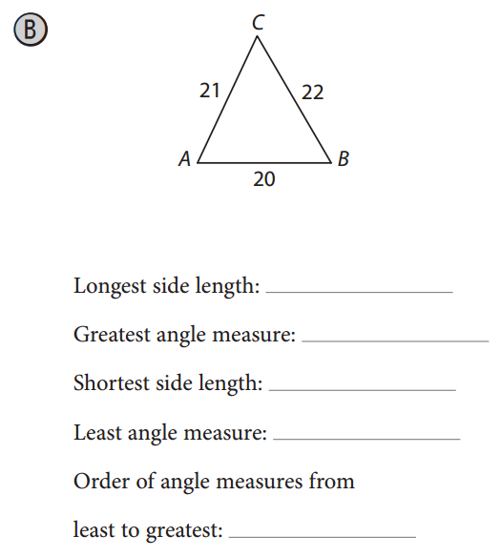
EXAMPLE 3B p. 758

Slide 16
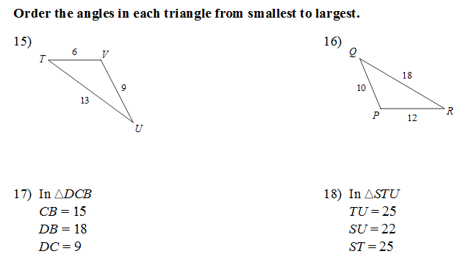
PRACTICE
WS 15.3A complete #15-18.

Slide 17
EXPLAIN 4
Angle-Side Relationships in Triangles
If two angles of a triangle are not congruent, then the longer side is opposite the larger angle.

Slide 18
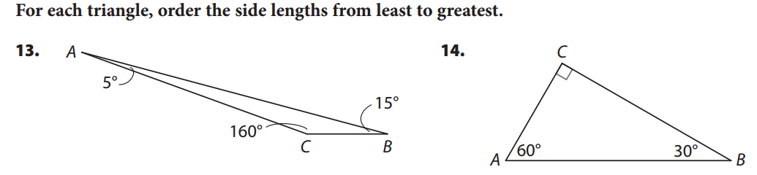
Your Turn
List the measures in order:
List the angle measures in order:
List the opposite sides in order:

Slide 19
Your Turn
List the measures in order:
List the angle measures in order:
List the opposite sides in order:

Slide 20
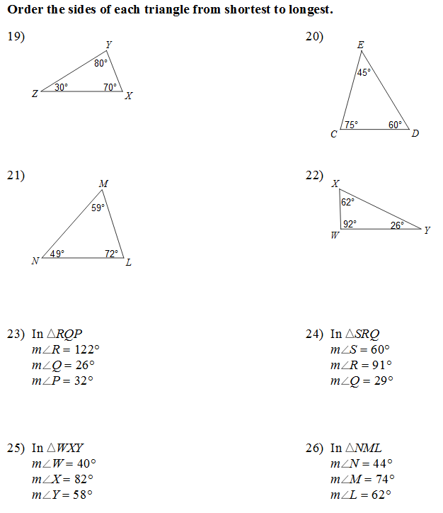
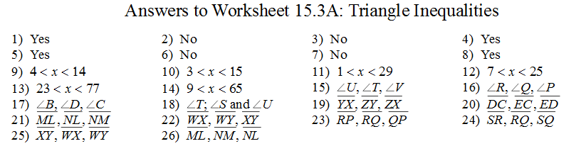
PRACTICE
WS 15.3A complete #19-26.

Slide 21
ASSIGNMENTS
WS 15.3B
pp. 732ff #3-9, 14-15
pp. 746f #4-11

Slide 23
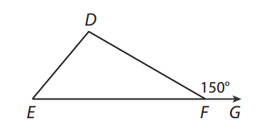
TICKET-OUT-THE-DOOR
Order the side lengths from least to greatest.
If ED = 5 and EF = 10, find the range of possible values for DF.
(2x)º
(x)º

