Slide 1
Mod 15.6:
Properties of Parallelograms
Essential Question: What can you conclude about the sides, angles, and diagonals of a parallelogram?
CASS: 11 Prove theorems about parallelograms. Also G-SRT.5 MP.3 Logic

Slide 2
VOCABULARY
p. 787
Quadrilateral = a polygon with four sides
Parallelogram = a quadrilateral that has two pairs of parallel sides.

Slide 3
EXAMPLE 1
Do you think it is true that opposite sides are congruent? How would you prove this?

Slide 4
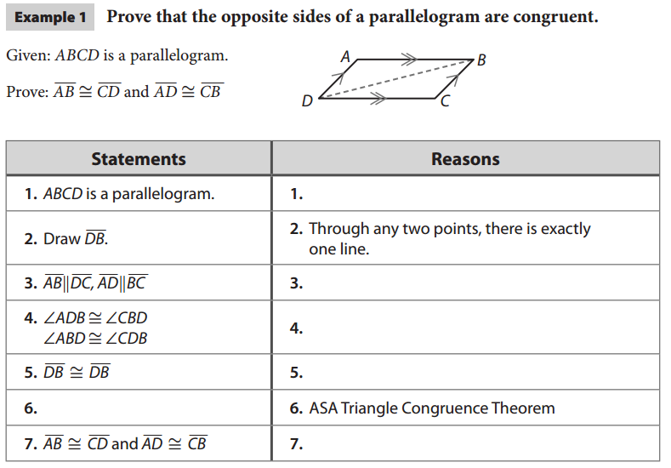
EXAMPLE 1
p. 789
Given
Definition of parallelogram
Alternate Interior Angles Thm
Reflexive Property
CPCTC

Slide 5
p. 789
Opposite Sides Theorem
If a quadrilateral is a parallelogram, then its opposite sides are congruent.
Q
R
P
S
and

Slide 6
EXAMPLE 2
Do you think it is true that opposite angles are congruent? How would you prove this?

Slide 7
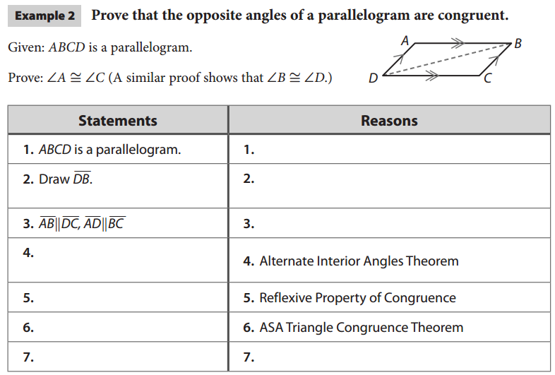
p. 790
Given
Through any two points, there is exactly one line.
Definition of parallelogram
CPCTC

Slide 8
p. 790
Opposite Angles Theorem
If a quadrilateral is a parallelogram, then its opposite angles are congruent.
Q
R
P
S
and

Slide 9
EXAMPLE 3
What do you think it is true about the diagonals? How would you prove this?

Slide 10
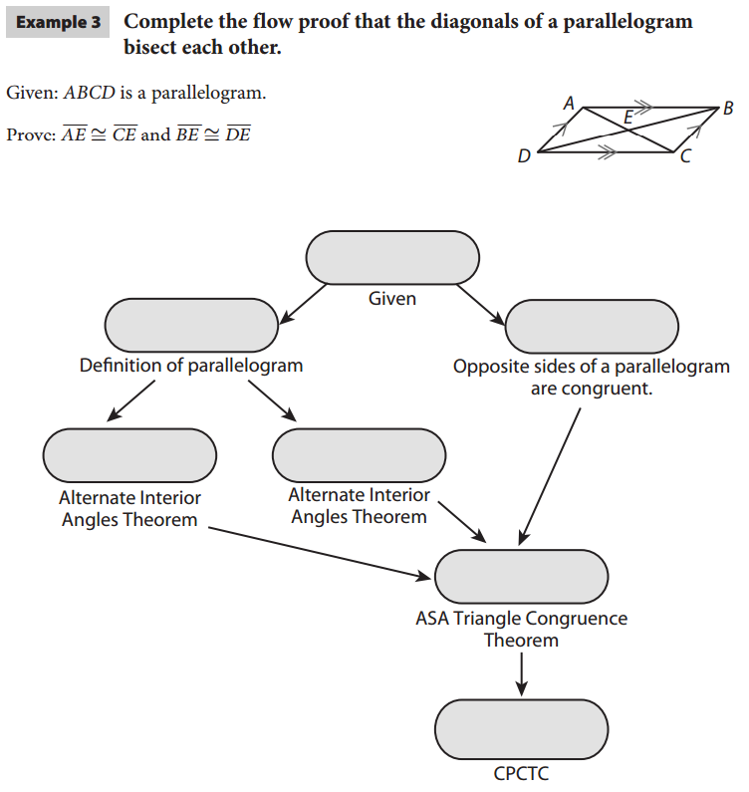
p. 791
ABCD is a parallelogram

Slide 11
p. 790
Diagonals Bisect Theorem
If a quadrilateral is a parallelogram, then its diagonals bisect each other.
Q
R
M
P
S
and

Slide 12
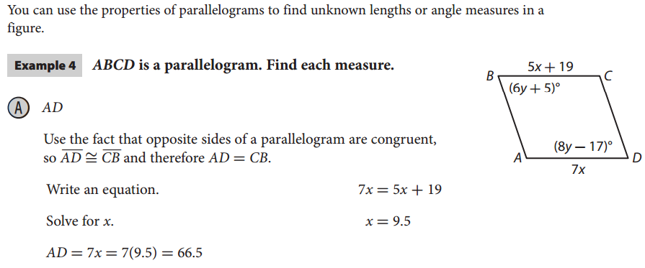
EXAMPLE 4A
p. 792
B
5x + 19
C
(6y + 5)º
(8y – 17)º
7x
A
D

Slide 13
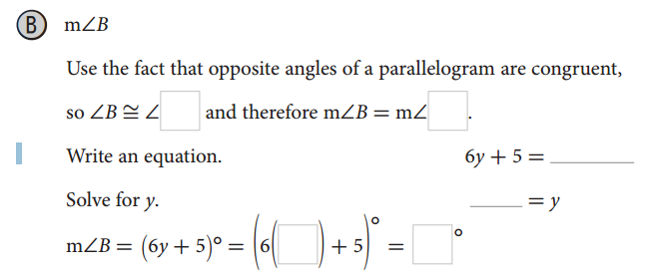
EXAMPLE 4B
p. 792
D
D
y – 17
11
11
71
B
5x + 19
C
(6y + 5)º
(8y – 17)º
7x
A
D

Slide 14
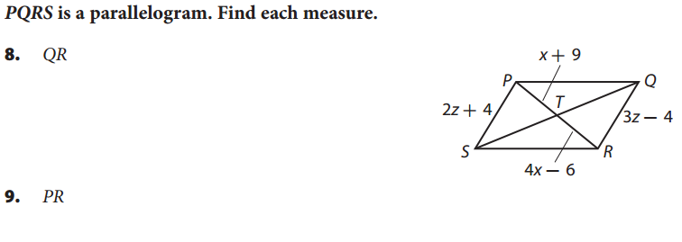
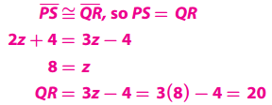
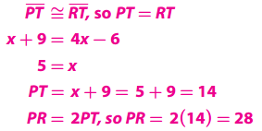
Your Turn
p. 793

Slide 15
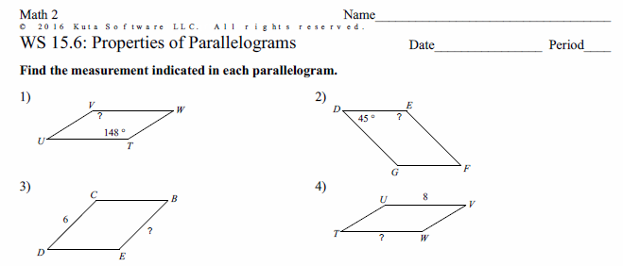
PRACTICE
If time permits, do WS 15.6

