Slide 1
Mod 15.7:
Conditions for Rectangles, Rhombi, and Squares
Essential Question: How can you use given conditions to show that a quadrilateral is a rectangle, a rhombus, or a square?
CASS: G-CO.10 : G-CO.11 Prove theorems about parallelograms.
Also G-SRT.5 MP.7 Using Structure

Slide 2
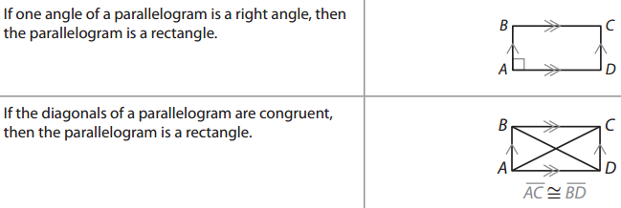
EXPLAIN 1
p. 803
Conditions for Rectangles

Slide 3




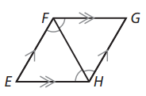

EXPLAIN 2
p. 804
Conditions for Rhombi

Slide 4
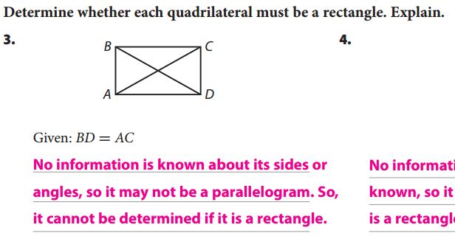
Your Turn
p. 808 (Evaluate)

Slide 5
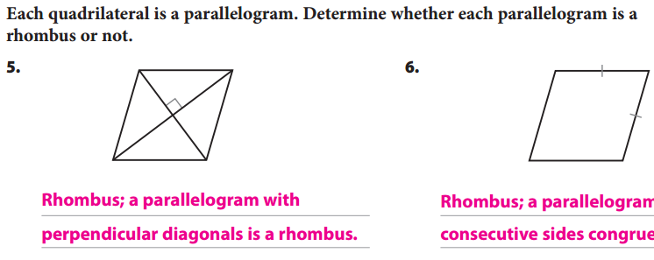
Your Turn
p. 809 (Evaluate)

Slide 6
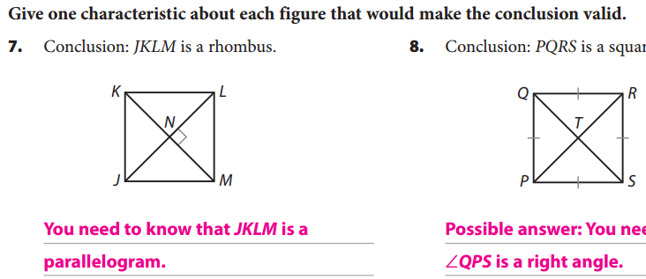
Your Turn
p. 809 (Evaluate)

Slide 7
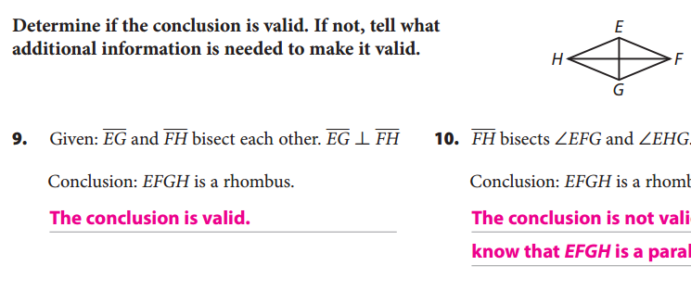
Your Turn
p. 809 (Evaluate)

Slide 8
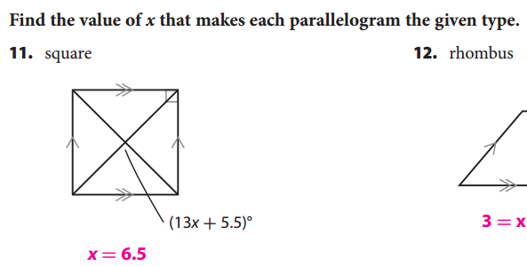
Your Turn
p. 809 (Evaluate)
Note: Your book may say (13x – 5.5)º. If so, fix it!

Slide 9
ASSIGNMENTS
WS 15.6
pp. 794f #3-9
pp. 808f #4-12

