Slide 1
Mod 16.1:
Dilations
Essential Question: What can you say about the interior and exterior angles of a triangle and other polygons?
CASS: G-SRT.1a, G-SRT.2b Properties of Dilations. MP.5 Using Tools

Slide 2
DISTANCE FORMULA
y
x

Slide 3
Using the Distance Formula
Find the length of AB given the coordinates A(-2, 5) and B(1, -1).

Slide 4
REVIEW
A rigid transformation preserves size and shape. In other words, the image and preimage are congruent.
Not all transformations are rigid.

Slide 5
Transformation
Tranformation – anything that maps (or moves) a pre-image to an image.
4 Basic types of transformations:
    1. Reflection
    2. Rotation
    3. Translation
    4. Dilation

Slide 6
Prime Notation
Pre image
Original shape or object.
A
Image
Shape or object after a transformation.
A’

Slide 7

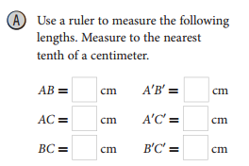
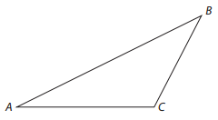
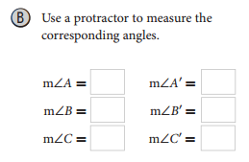

EXPLORE 1
p. 827
6
3
4
2
3
1.5

Slide 8
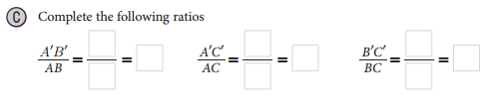




EXPLORE 1
p. 827

Slide 9
Properties preserved under a dilation:
p. 829
  1. angle measures (remain the same)
  2. collinearity (points stay on same lines)
  3. orientation (lettering order remains the same)
  4. betweenness (points stay on same lines and order)
  5. scale factor (ratio of corresponding side)
  side lengths NOT preserved (except for a scale factor of 1)

Slide 10
Vocabulary
Dilation: type of transformation which contains reduction and enlargement.
Dilation Scale Factor:
Reduction: 0 < k < 1
Enlargement: k > 1
Center of a Dilation: where the lines through all corresponding points intersect

Slide 11
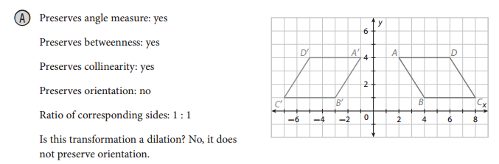
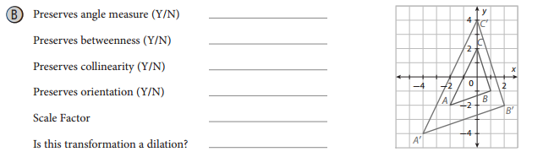
EXAMPLE 1
p. 829
Determine if the transformation on the coordinate plane is a dilation.
If it is, give the scale factor.

Slide 12
Identifying Dilations
Identify the dilation and find its scale factor (k).
P
5
preimage
P’
2
image
Since k < 1, it’s a reduction
and the scale factor is 2:5
C

Slide 13
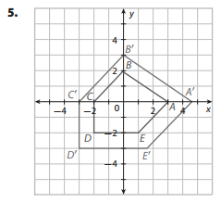
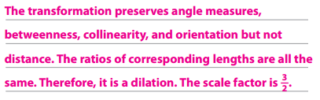
Your Turn
p. 830

Slide 14
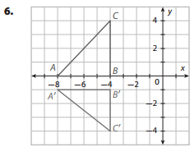
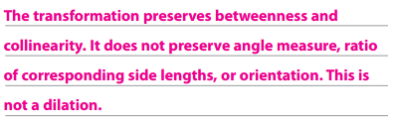
Your Turn
p. 830

Slide 15
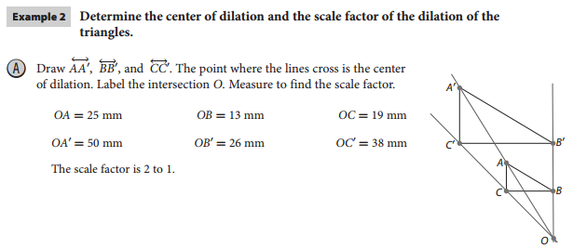
EXPLAIN 2
p. 830
When you have a figure and its image after dilation, you can find the center of dilation by drawing lines that connect corresponding vertices. These lines will intersect at the center of dilation.

Slide 16
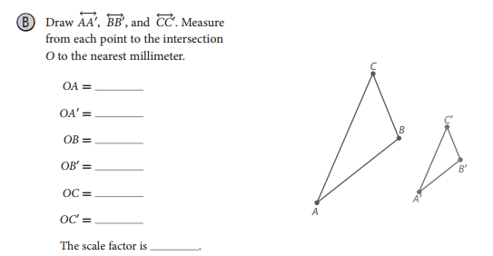
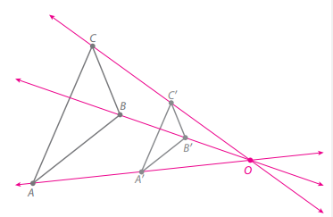

EXAMPLE 2
p. 831
60 mm
30 mm
38 mm
19 mm
52 mm
26 mm
1 to 2 or $\frac{1}{2}$

Slide 17
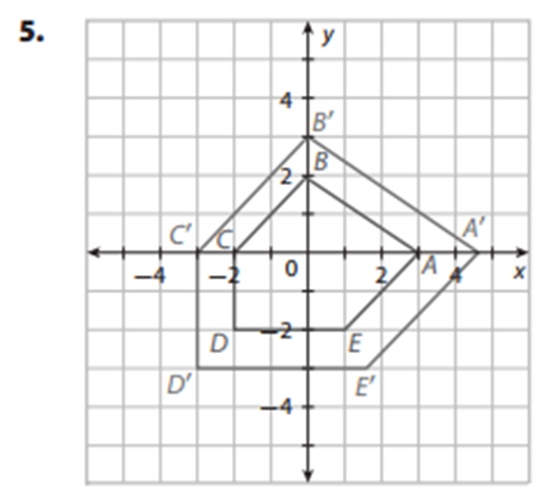
REFLECT
p. 831
7. For the dilation in Your Turn 5, what is the center of dilation?
Explain how you can tell without drawing lines.
The ORIGIN.

Slide 18
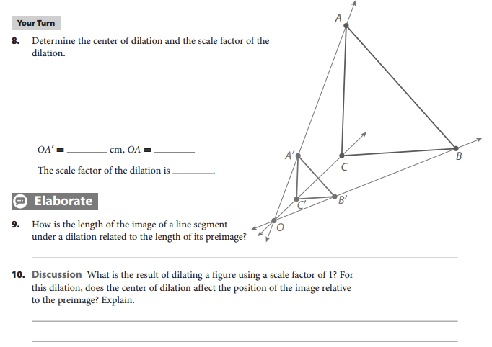
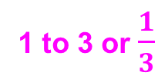
Your Turn
p. 831
18 mm
54 mm
1 to 3 or $\frac{1}{3}$

Slide 19
ASSIGNMENTS
pp. 832ff #1-17
for EC do p. 835 #19
Key Content:
Dilation
  Pre-image and Image
  Center of Dilation
  Scale Factor
    Reduction
    Enlargement

