Slide 1
Mod 16.3:
Corresponding Parts of Similar Figures
Essential Question: If two figures are similar, what can you determine about measures of corresponding angles and lengths?
CASS: G-SRT.2 Similarity. MP.4 Modeling

Slide 2
Essential Question:
If two figures are similar, what can you determine about measures of corresponding angles and lengths?

Slide 3
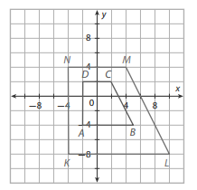
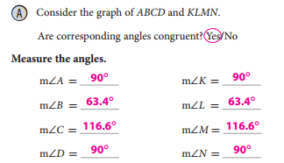
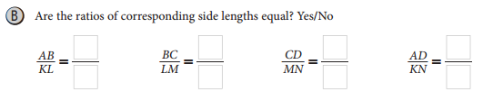

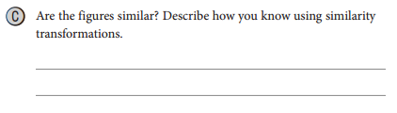

EXPLORE 1
p. 851

Slide 4
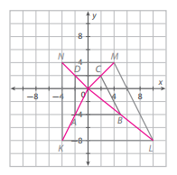

EXPLORE 1
p. 851

Slide 5
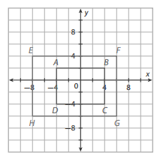
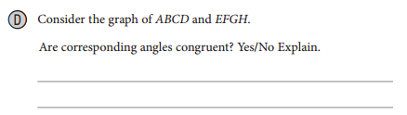

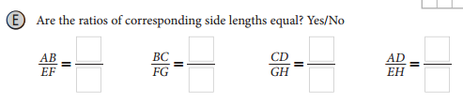

EXPLORE 1
p. 852

Slide 6
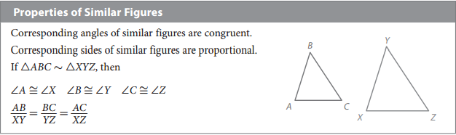
EXPLAIN 1
p. 853
Two figures that can be mapped to each other by similarity transformations (dilations and rigid motions) are similar. Similar figures have certain properties.

Slide 7
Vocabulary
B
C
similar polygons:
Two polygons are similar, the side lengths are proportional and the angle measures are equal.
A
D
F
G
The symbol for similar is ~
E
H

Slide 8
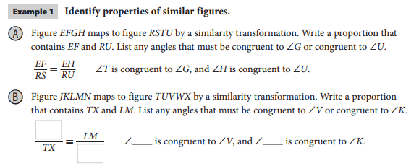
EXAMPLE 1
p. 853
JN
L
U
VW

Slide 9
REFLECT
p. 854
4. If you know two figures are similar, what angle or side measurements must you know to find the dilation used in the transformations mapping one figure to another?
You must know measurements of one pair of corresponding sides to find the scale factor.

Slide 10
Your Turn
p. 854
5. Triangles △PQR and △LMN are similar. If QR = 6 and MN = 9, what similarity transformation (in coordinate notation) maps △PQR to △LMN?
No.
No, the proportion must compare corresponding sides.

Slide 11
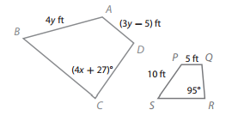
EXPLAIN 2
p. 854, Example A
Find the value of x and y.
Hint:
Rotate polygon PQRS clockwise by 45° to see similarity.
x = 17
y = 5

Slide 12
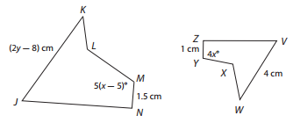
EXPLAIN 2
p. 854, Example B
Find the value of x and y.
Hint:
Rotate figures and write similarity statement.
JKLMN ~ VWXYZ

Slide 13
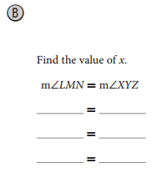
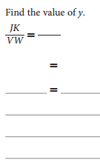
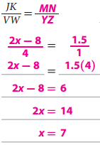

EXPLAIN 2
p. 854, Example B
Find the value of x and y.
JKLMN ~ VWXYZ
y = 7

Slide 14
REFLECT
7. Discussion: What are some things you need to be careful about when solving problems involving finding the values of variables in similar figures?
Set up side lengths proportion correctly.
Side lengths are proportional rather than equal.
Errors in the calculations.

Slide 15
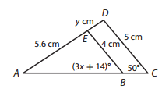
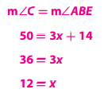
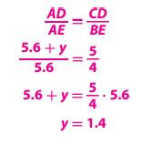
Your Turn
p. 855
Use the diagram, in which △ABE ∼ △ACD.
8. Find the value of x.
9. Find the value of y

Slide 16

ELABORATE
p. 855
Similar figures have corresponding angles that are congruent and have corresponding sides that are proportional.

Slide 17
Essential Question:
If two figures are similar, what can you determine about measures of corresponding angles and lengths?
EQ Answer: Similar figures have corresponding angles that are congruent and have corresponding sides that are proportional.

