Slide 1
Warm Up
If AD = 16 and BD = 4 and AC = 9, find AE.
A
B
C
D
E

Slide 3
Mod 17.1:
Triangle Proportionality Theorem
Essential Question: When a line parallel to one side of a triangle intersects the other two sides, how does it divide those sides?
CASS: Prove theorems about triangles. Also G-CO.10, G-CO.12, G-SRT.5
MP.5 Using Tools

Slide 4
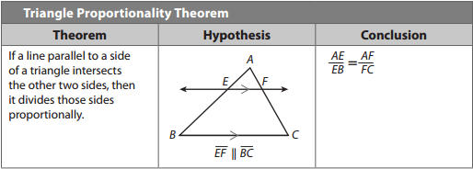
EXPLAIN 1
p. 882

Slide 5
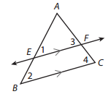
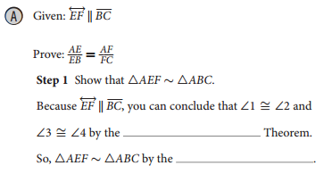

EXAMPLE 1
p. 882

Slide 6
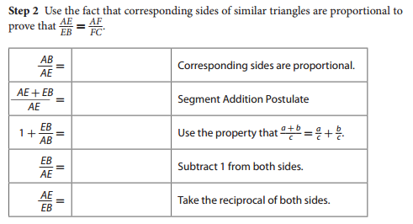
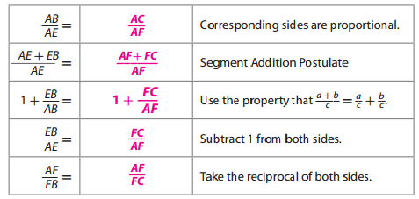
EXAMPLE 1
p. 883

Slide 7

REFLECT
p. 883
4. Explain how you conclude that ▵AEF ∼▵ABC without using ∠3 and ∠4.

Slide 8
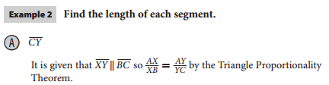
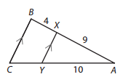
EXPLAIN 2
p. 883

Slide 9


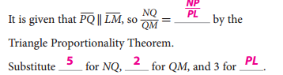

EXPLAIN 2
p. 883

Slide 10
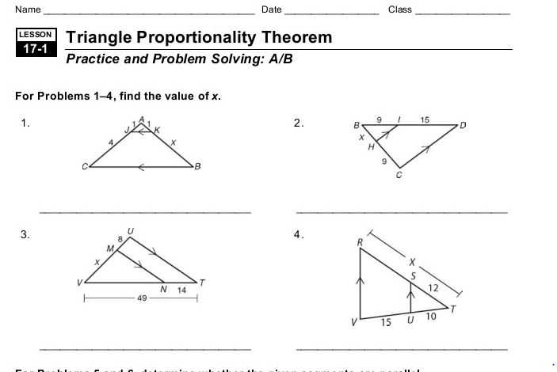
Start WS 17.1, #1-4

Slide 11
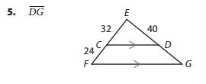
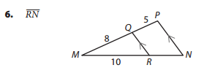
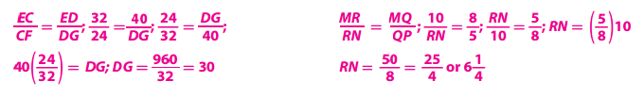
Your Turn
p. 884

Slide 12
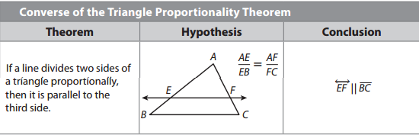
EXPLAIN 3
p. 884

Slide 13
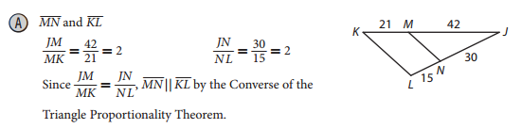
EXAMPLE 4
p. 885

Slide 14
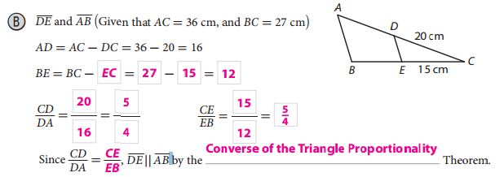
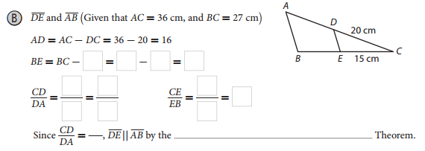

EXAMPLE 4
p. 885

Slide 15
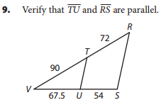
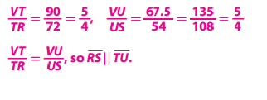
Your Turn
p. 885

Slide 16
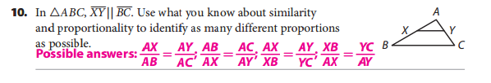

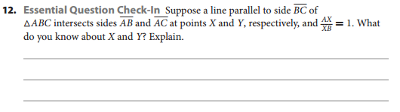

ELABORATE
p. 886
Draw a diagram.

Slide 17
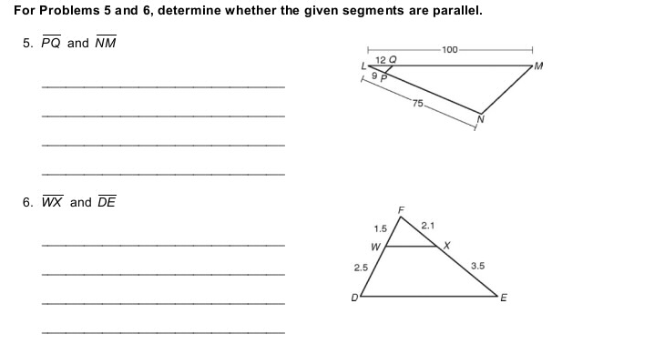
Finish WS 17.1

Slide 18
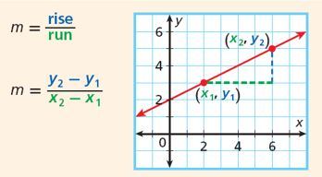
Slope (m)

Slide 19
Example
Graph the line containing the points
( -4, 2) and ( 2, -3) and find the slope.
y
x

Slide 20
ASSIGNMENTS
pp. 897 # 5-8; and for EC #19

