Slide 1
Mod 17.2:
Subdividing a Segment in a Given Ratio
Essential Question: How do you find the point on a directed line segment that partitions the given segment in a given ratio?
CASS: G-GPE.6 Find the point on a directed line segment between two given points that partitions the segment in a given ratio.
Also G-CO.12
MP.5 Using Tools

Slide 2
Revisit the Essential Question:
How can you show that two triangles are similar?

Slide 3

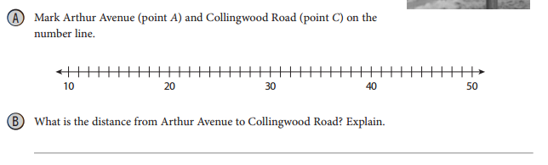
EXPLORE 1
Partitioning a Segment in a One-Dimensional Coordinate System
p. 891

Slide 4



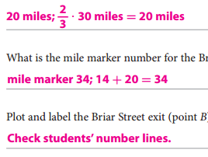
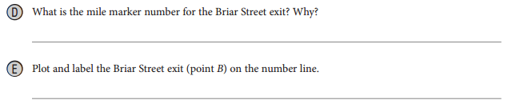
EXPLORE 1
Partitioning a Segment in a One-Dimensional Coordinate System
p. 891

Slide 5

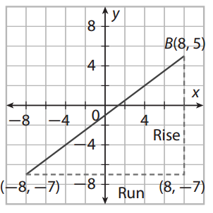
EXPLAIN 1
Partitioning a Segment in a Two-Dimensional Coordinate System
p. 892
Steps:
Mark both points of graph paper.
Calculate slope: graphically or formula.
Simplify slope.
Start at point A and use slope to partition the segment.
Point P: 3 to 1 ratio means 3 out of 4.
Write coordinate of point P

Slide 6
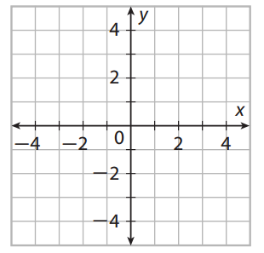
EXPLAIN 1
Partitioning a Segment in a Two-Dimensional Coordinate System
p. 893
Steps:
Mark both points of graph paper.
Calculate slope: graphically or formula.
Simplify slope.
Start at point A and use slope to partition the segment.
Point P: 3 to 1 ratio means 3 out of 4.
Write coordinate of point P

Slide 7
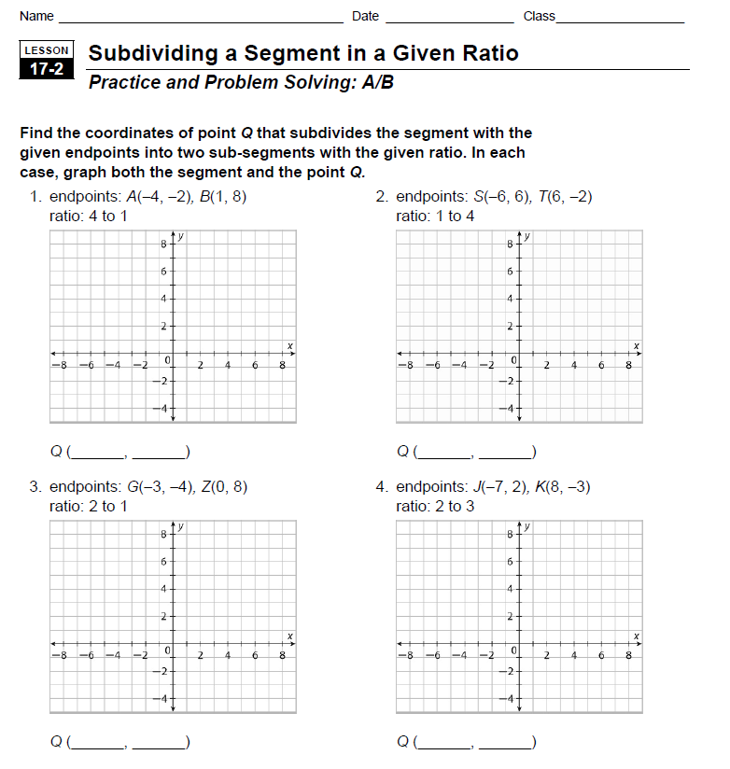
Do WS 17.2, #1-4

Slide 8
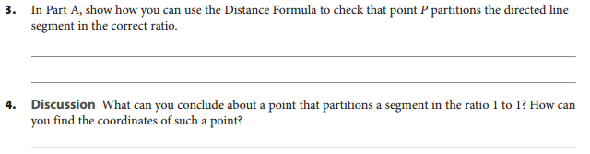
REFLECT
p. 893
The point is the midpoint of the segment. Use the midpoint formula.

Slide 9
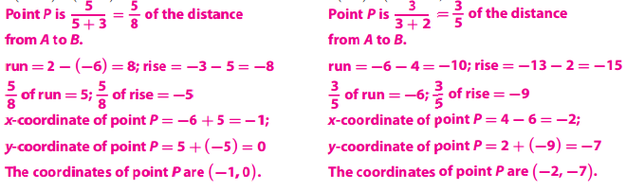
Your Turn
p. 894

Slide 10
Revisit the Essential Question:
How do you find the point on a directed line segment that partitions the given segment in a given ratio?
If the segment lies on a number line, subtract the coordinates to find the distance between the endpoints. Then multiply the length by the ratio to find the coordinate of the point that divides the segment in that ratio. If there are no coordinates, use a compass and straightedge to divide the given segment into equal parts, and identify the point that divides the segment in the given ratio.

Slide 11
ASSIGNMENTS
pp. 887f #3-10, 14
pp. 897 # 5-8; and for EC #19

