Slide 1
Mod 17.3:
Using Proportional Relationships
Essential Question: How can you use similar triangles to solve problems?
CASS: Use congruence and similarity criteria for triangles to solve problems and to prove relationships in geometric figures. G-SRT.5
MP.5 Using Tools

Slide 2
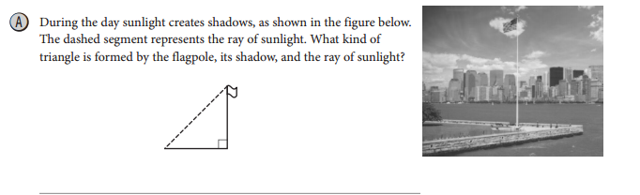
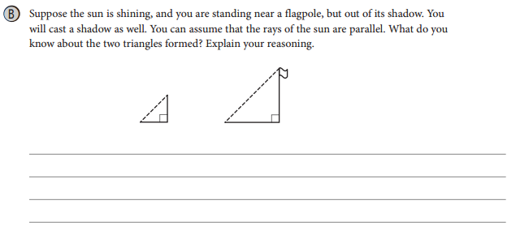
EXPLORE 1
p. 903
Indirect measurement involves using the properties of similar triangles to measure such heights or distances.
A right triangle
The triangles are similar by the AA Similarity Criterion.

Slide 3

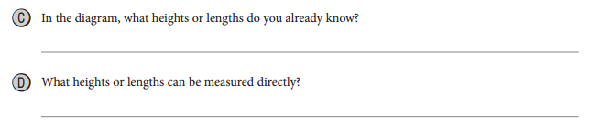
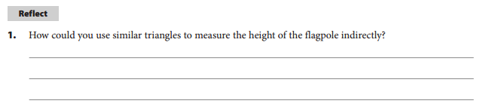
EXPLORE 1
p. 903
You probably know your own height.
Your height (if necessary) and the lengths of your shadow
and the shadow of the flagpole.
Have someone measure the length of your shadow and the shadow of the flagpole. Write and solve a proportion in which the unknown is the height of the flagpole. Use the fact that corresponding sides of similar triangles are proportional.

Slide 4

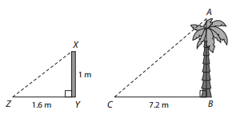

EXAMPLE 1
p. 904

Slide 5
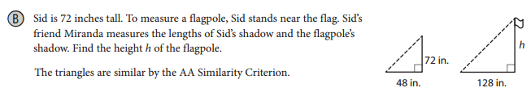



EXAMPLE 1
p. 904
flagpole
flagpole

Slide 6
REFLECT
p. 905
2. In the tree example, how can you check that your answer is reasonable?
The length of the meter stick’s shadow is a little more than 1.5 times the length of the meter stick.
So the length of the tree’s shadow, should be a little more than 1.5 times the height of the tree.
Since 1.5 (4.5) = 6.75, an answer of 4.5 is reasonable

Slide 7
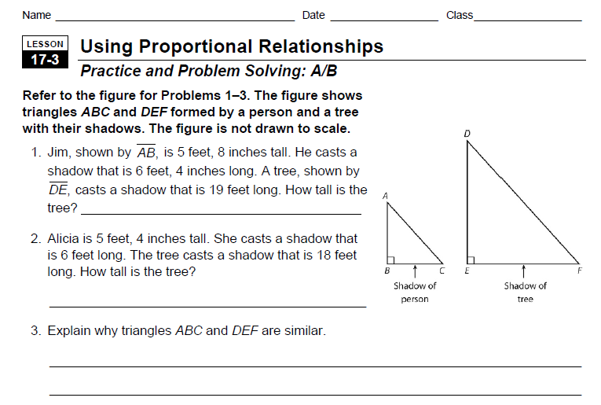
PRACTICE
Do WS 17.3, #1-3

Slide 8

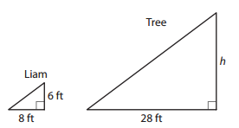


Your Turn
p. 905
3. Liam is 6 feet tall. To find the height of a tree, he measures his shadow and the tree’s shadow. The measurements of the two shadows are shown.
Find the height h of the tree.

Slide 9
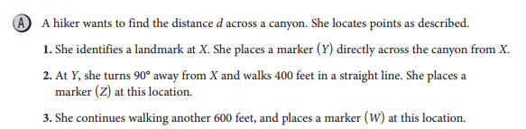
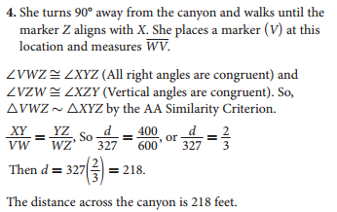
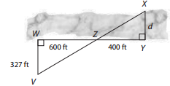
EXAMPLE 2
p. 905

Slide 10

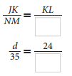

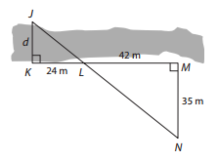

EXAMPLE 2
p. 905
20 meters

Slide 11
REFLECT
p. 906

Slide 12
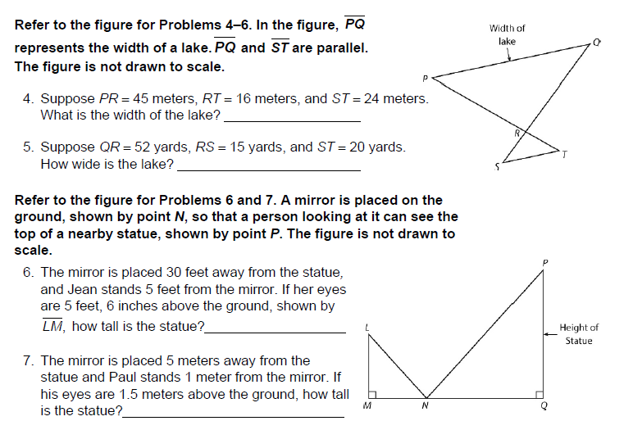
PRACTICE
Do WS 17.3, #4-7

Slide 13
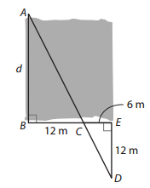

Your Turn
p. 906
5. To find the distance d across a stream, Levi located points as shown in the figure. Use the given information to find d.

Slide 14
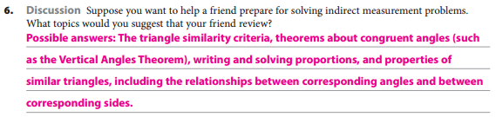
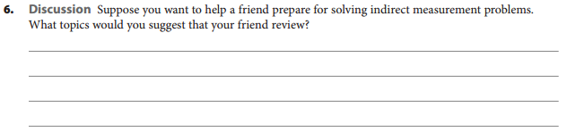


ELABORATE
p. 906

Slide 16
ASSIGNMENTS
pp. 907f # 1 – 12 all

Slide 17
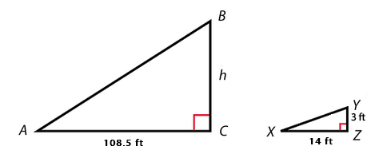
TICKET-OUT-THE-DOOR
Use similar triangles ABC and triangle XYZ to find the missing height h. Round to the nearest tenth if necessary.

