Slide 1
Warm Up
A 40-foot flagpole casts a 25-foot shadow. Find the shadow cast by a nearby building 200 feet tall.
a) Draw a diagram.
b) How long is the shadow of the building?

Slide 2
Mod 17.4:
Similarity in Right Triangles
Essential Question: How does the altitude to the hypotenuse of a right triangle help you use similar right triangles to solve problems?
CASS: Prove theorems about triangles. Also G-SRT.5
MP.8 Patterns

Slide 3
Essential Question:
How does the altitude to the hypotenuse of a right triangle help you use similar right triangles to solve problems?

Slide 4
Criteria for SIMILAR POLYGONS
All corresponding angles are congruent
All corresponding sides are proportional

Slide 5

Index card demo of similar right triangles

Slide 6
How many triangles do you see?
C
A
A
C
A
B
D
D
B
D
C
C
B

Slide 7
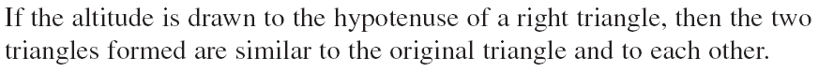
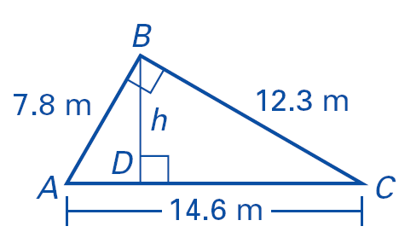
Three Similar Triangles Theorem
small ∆ ~ medium ∆
ΔADB ~ ΔBDC
small ∆ ~ large ∆
ΔADB ~ ΔABC
medium ∆ ~ large ∆
ΔBDC ~ ΔABC

Slide 8
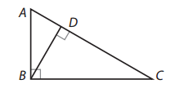
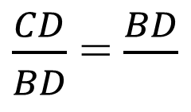
EXAMPLE 1
Write similarity statements for the three similar triangles in the diagram. Then complete the proportion.
$\frac{CD}{BD}$ = $\frac{BD}{ }$
small ∆ ~ medium ∆
  ΔBAD ~ ΔCBD
small ∆ ~ large ∆
  ΔBAD ~ ΔCAB
medium ∆ ~ large ∆
  ΔCBD ~ ΔCAB

Slide 9
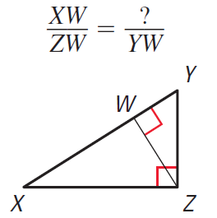
TRY THIS
Write similarity statements for the three similar triangles in the diagram. Then complete the proportion.
small ∆ ~ medium ∆
  ΔZYW ~ ΔXZW
small ∆ ~ large ∆
  ΔZYW ~ ΔXYZ
medium ∆ ~ large ∆
  ΔXZW ~ ΔXYZ

Slide 10
Geometric Mean
The geometric mean of two positive numbers a and b is the positive number x such that
Find the geometric mean of 8 and 18.

Slide 11
Different Perspective on Geometric Mean
The geometric mean of ‘a’ and ‘b’ is
Therefore geometric mean of 4 and 9 is 6, since

Slide 12
Examples
Find the geometric mean of 5 and 20.
The geometric mean of x and 5 is 15. Find the value of x.

Slide 13
Try
Find the geometric mean of 18 and 2.
The geometric mean of x and 4 is 10. Find the value of x.

Slide 14
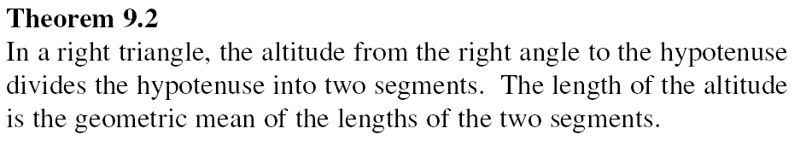
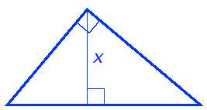
Altitude Geometric Mean Theorem
B
altitude
AD
BD
BD
DC
=
A
C
D
short:long = short:long

Slide 15
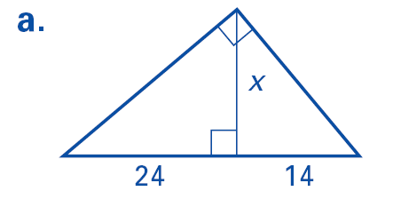
EXAMPLE 2
Find the value of the variable. Round decimals to the nearest tenth.
The altitude is the geometric mean of the two pieces of the hypotenuse.

Slide 16
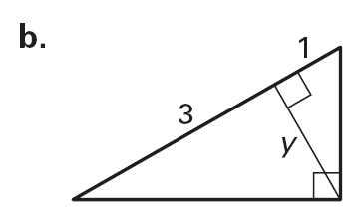
TRY THIS
Find the value of the variable. Round decimals to the nearest tenth.
The altitude is the geometric mean of the two pieces of the hypotenuse.

Slide 17
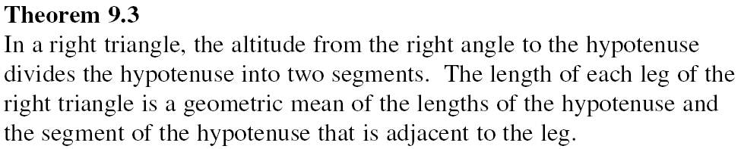
Hypotenuse-Leg Geometric Mean Theorem
AD
AB
AB
AC
B
=
B
DC
BC
BC
AC
=
A
C
A
D
C
D

Slide 18
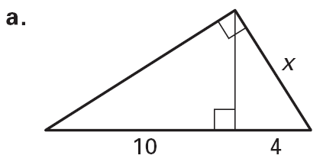
EXAMPLE 3
Find the value of the variable. Round decimals to the nearest tenth.

Slide 19
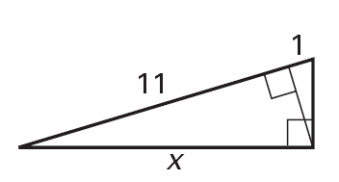
TRY THIS
Find the value of the variable. Round decimals to the nearest tenth.

Slide 20
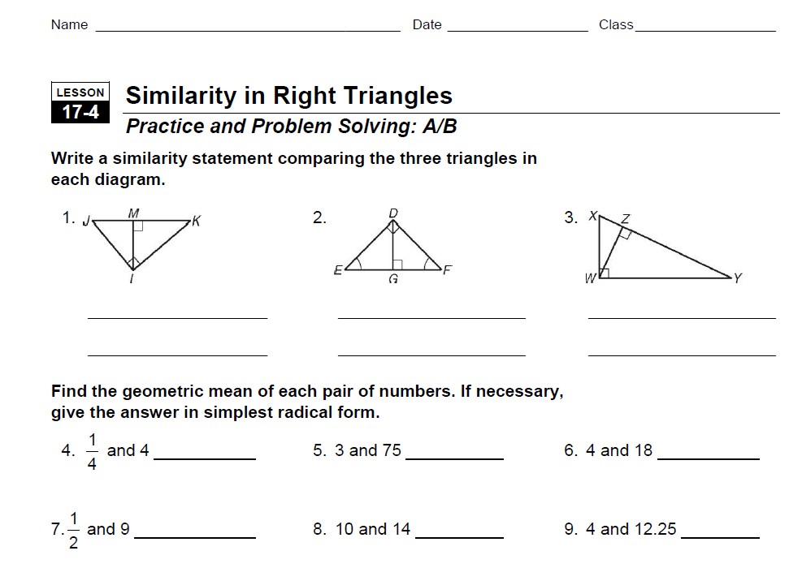
PRACTICE
Do WS 17.4

Slide 21
Revisit the Essential Question:
How does the altitude to the hypotenuse of a right triangle help you use similar right triangles to solve problems?
The altitude to the hypotenuse of a right triangle divides the triangle into two smaller triangles that are similar to each other and to the original triangle. You can use the geometric means theorems to find missing measurements using indirect measurement.

Slide 22
Assignments
pp. 921f #1-12 all
WS 17.4 AB

Slide 23
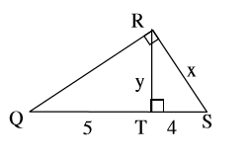
TICKET-OUT-THE-DOOR
Find the value of each variable.
Leave answers in simplest radical form. Show work!!!!

