Slide 1
Lesson 19.1-19.2 Warm-Ups
Of the 10 numerals and 26 letters we use, some are made of straight lines, others are made of curves (parts of circles or ovals), and some are made of both straight and curved lines. Classify them in the boxes below. How many there are of each. Do you notice any patterns?
only straight lines | only curves | straight and curved lines
1 | 3 | 2

Slide 2
Mod 19.1:
Central Angles and Inscribed Angles
Essential Question: How can you determine the measures of central angles and inscribed angles of a circle?
CASS: G-C.2 Identify and describe relationships among inscribed angles, radii, and chords. MP.2 Reasoning

Slide 3
p. 1005
central angle
Vocabulary
A
arc
P
chord
B
central angle = an angle less than 180° whose vertex lies at the center of a circle
arc = continuous portion of a circle consisting of two points (called the endpoints of the arc) and all the points on the circle between them.
chord = a segment whose endpoints lie on a circle

Slide 4
p. 1006
MEASURING ARCS
G
A minor arc is an arc that measures less than 180°. It is named with 2 letters. The measure of a minor arc is the measure of its central angle:
E
60°
F
H
A major arc is an arc that measures greater than 180°. It is named with three letters. The measure of a major arc is difference between 360° and the measure of its associated minor arc:
A semicircle is an arc whose endpoints are the endpoints
of a diameter.

Slide 5
p. 1007
Definitions:
congruent arcs = two arcs of the same circle or of congruent circles that have the same measure.
adjacent arcs = two arcs of the same circle that intersect in exactly one point.
Arc Addition Postulate
The measure of an arc formed by two adjacent arcs is the sum of the measures of the two arcs.
A
B
72°
115°
C

Slide 6
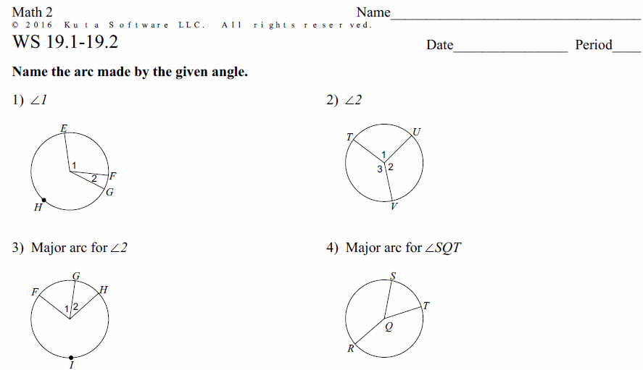
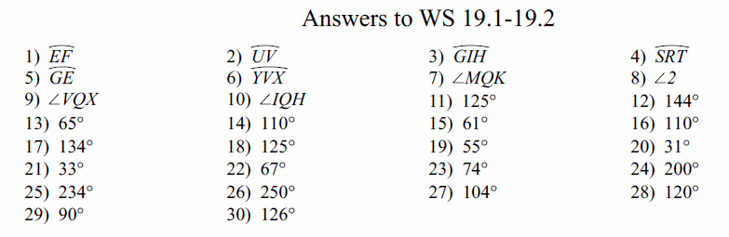
PRACTICE
Do WS 19.1-19.2, #1-18

Slide 7
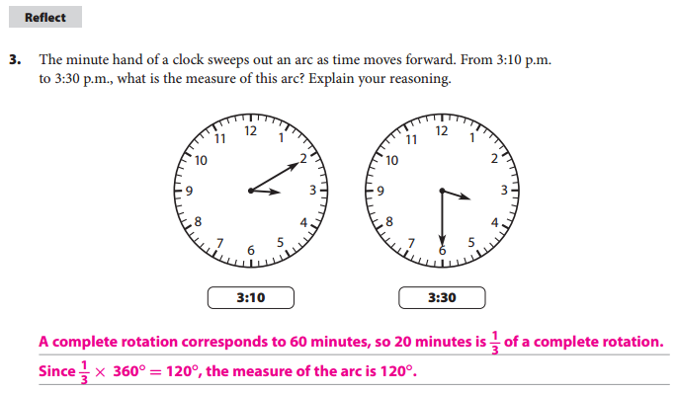
p. 1008
CHALLENGE

Slide 8
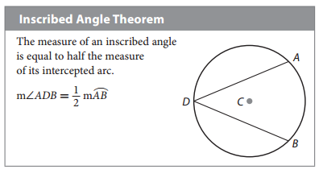
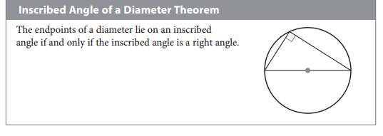
p. 1008
p. 1011

Slide 9
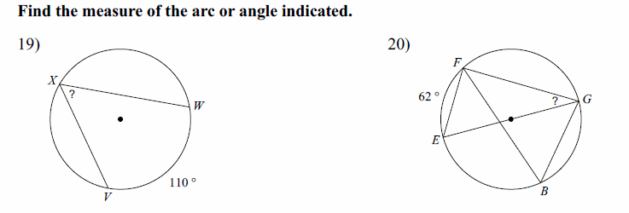
PRACTICE
Do WS 19.1-19.2, #19-30

Slide 10
EXPLORE
Comparing Measures of Inscribed Angles
Find and
B
C
A
D
90°
E
What do you notice about the measures of the angles? Why is this true?

Slide 11
CHALLENGE
B
C
Solve for x and y.
x°
63°
y°
D
15°
A

Slide 13
Mod 19.2: Angles in Inscribed Quadrilaterals
Essential Question: What can you conclude about the angles of a quadrilateral inscribed in a circle?
CASS: G-C.3 Construct the inscribed and circumscribed circles of a triangle, and prove properties of angles for a quadrilateral inscribed in a circle. Also G-C.13 MP.4 Modeling

Slide 14
Inscribed Quadrilateral Theorem
p. 1020
If a quadrilateral is inscribed in a circle then opposite angles must be supplementary.
m∠P + m∠Y = 180°
m∠M + m∠A = 180°
A
80º
P
92º
100º
88º
M
Y

Slide 15
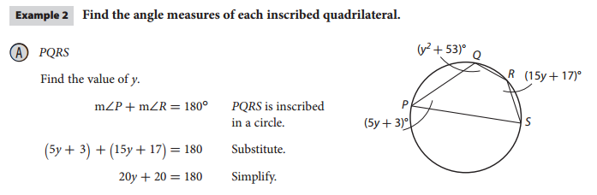
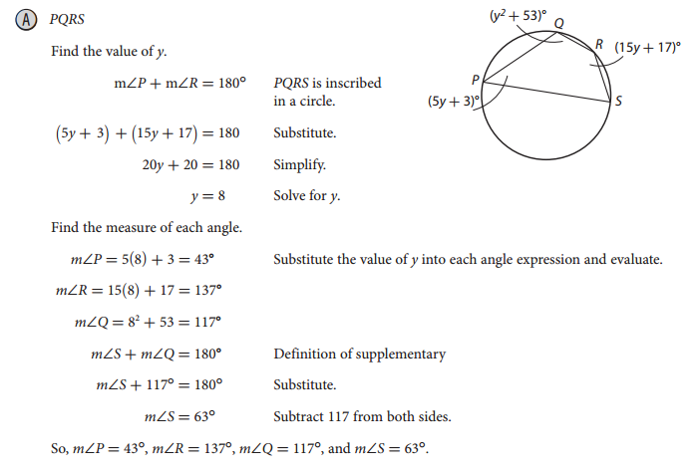
p. 1021
EXAMPLE 2A

Slide 16
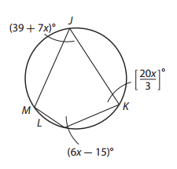
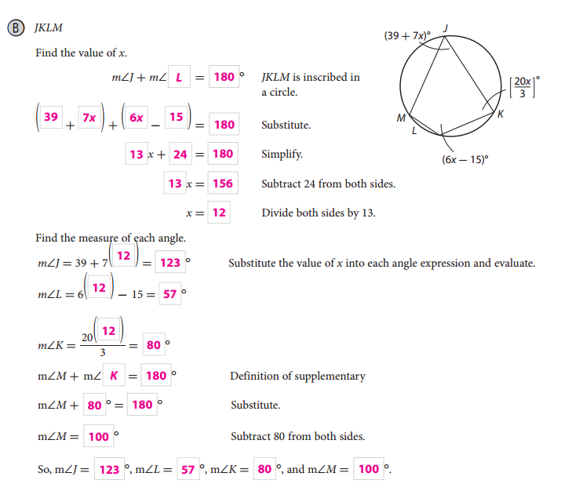
p. 1022
EXAMPLE 2B

Slide 17
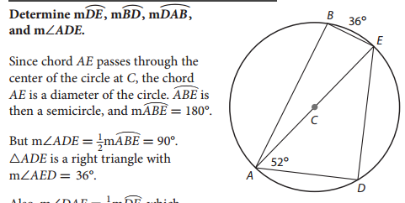
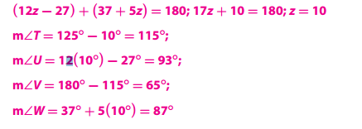
Your Turn
p. 1009

Slide 18
Inscribed Right Triangle Theorem
p. 1011
If a right triangle is inscribed in a circle then the hypotenuse is the diameter.
If the hypotenuse of an inscribed triangle is the diameter then it is a right triangle.
m∠Y = 90°
AM is the diameter
A
C
43º
M
Y
Note: The converse is also true.

Slide 19
EXAMPLE 3
Solve for x.
B
C
3x°
D

Slide 20
EXAMPLE 4
Solve for x.
108°
B
x°
C
D
Since BD is a diameter,

Slide 21
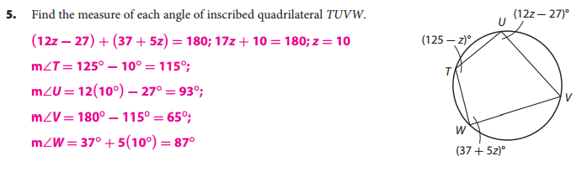
Your Turn
p. 1022

Slide 22
ASSIGNMENTS
WS 19.1-19.2
pp. 1012ff #5-13
pp. 1026f #5-13 (skip #9)

