Slide 1
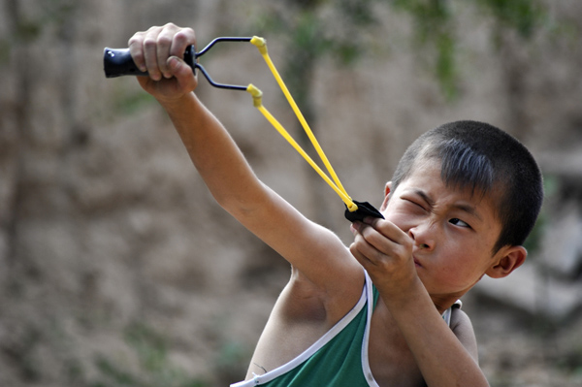
Lesson 19.5 Warm-Ups
Jamal uses a slingshot and BBs to hit a target 100 feet away. When he pulls the sling back 15 inches, it forms an angle of 20°. When he releases the BB, it falls about 20 feet short of the target.
How far should Jamal pull the BB for his next shot? Why? What will happen to the angle?

Slide 2
Mod 19.5: Angle Relationships in Circles
Essential Question: What are the relationships between angles formed by lines that intersect a circle?
CASS: G-C.2 Identify and describe relationships among inscribed angles, radii, and chords. MP.3 Logic

Slide 3



Review: Arcs
Recall there are major and minor arcs.
A
We name minor arcs with two letters.
We name major arcs with three letters.
We measure arcs by the measure of their central angle.
P
60º
Y

Slide 4
Review: Central Angles
Is the angle here a central angle?
YES!
NO
YES!
NO

Slide 5
Review: Central Angles
Angles:
Formula:
Central angles: vertex is at the center of the circle
Diagrams:
A
P
C
Y

Slide 6
Angles “In the Circle” (between chords)
Angle:
Formula:
Vertex is inside the circle, but not at the center
Diagrams:
T
1
A
2
P
Y

Slide 7
Example 1
Find x.
68°
y°
2x°
76°
84°
“inside the circle”
Find y.

Slide 8
Try:
T
A
Find mAT.
50º
INSIDE the circle
P
70º
Y

Slide 9
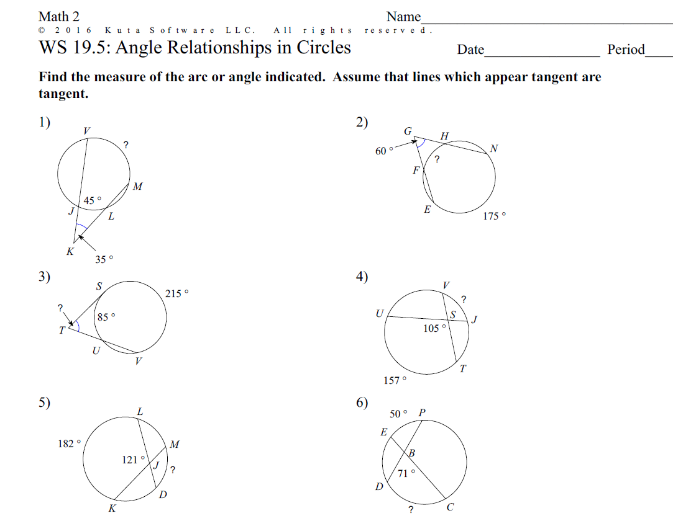
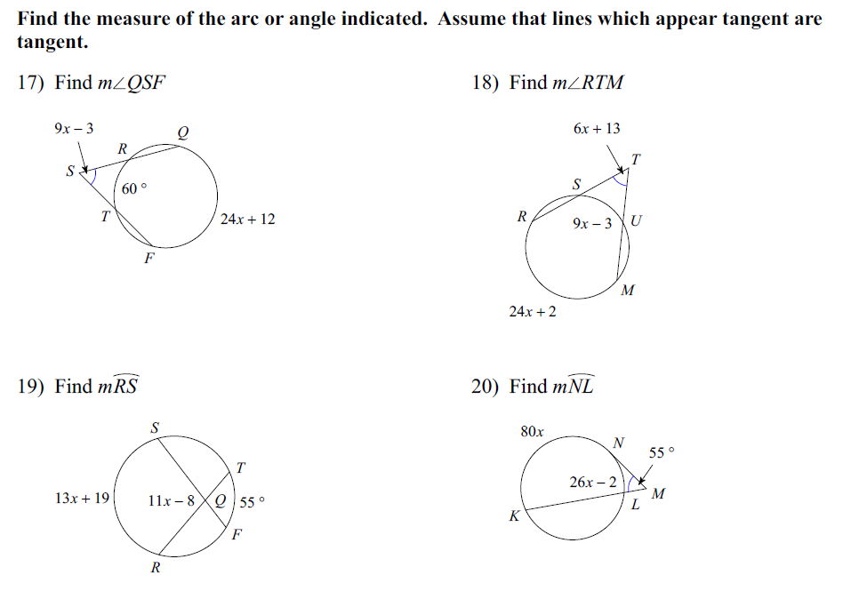
PRACTICE
Do WS 19.5 #4, 5, 6, 10, 14, and 19
Answers:
(4) 53°
(5) 60°
(6) 92°
(10) 9
(11) 9
(12) 149°

Slide 10
Inscribed Angles: “On the Circle”
Angle:
Formula:
Inscribed angles: vertex is on the circle
Diagrams:
A
A
1
P
P
2
Y
Y

Slide 11
Example 2
“on the circle”
Find m∠P.
P
(5x-1)°
98°
Find x.

Slide 12
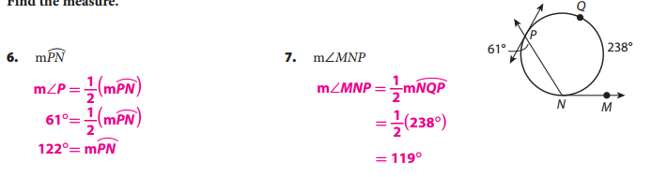
Example 3: Find the measure.

Slide 13
Try
160°
Find x.
Find m∠1.
Find m∠2.
Notice anything?
xº
A
1
P
2
Y
200º

Slide 14
Angles “Outside the Circle”
Angles
Formula
Vertex is outside the circle
Diagrams
A
A
A
M
3
1
2
P
P
P
Y
Y
Y

Slide 15
Example 4
80º
A
What is the measure of arc MP?
What is the measure of arc AY?
What is the measure of ∠1?
M
1
xº
2x+30º
P
x = 50
2(50) + 30 =
130
100º
Y
Is the angle on, inside,
or outside the circle?
OUTSIDE the circle
m∠1 = 40°

Slide 16
Ice Cream Cone Problem
Example 5
Find x.
(360-2x)°
60°
2x°
J
“outside the circle”

Slide 17
Review
If two lines intersect a circle, there are three places where the lines can intersect. There are three formulas you will need to solve for angles.
Theorem
inside
outside
on

Slide 18
INTEGRATED EXAMPLE
Find the value of w, x, y and z.
(y)°
30°
(x)°
(w)°
96°
(z)°

Slide 19
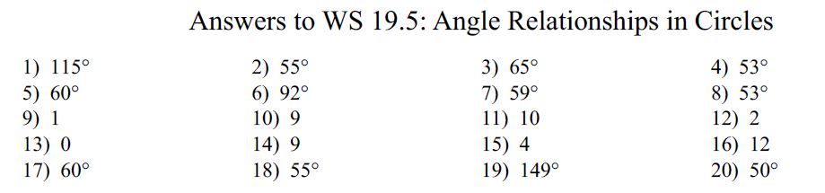
PRACTICE
Do WS 19.5 (all the rest)

Slide 20
Problem Set:
pp. 1062f #3-14
WS 19.5

Slide 21
TICKET-OUT-THE-DOOR
Find the value of a, b, c and d.
(b)°
(c)°
100°
(d)°
(a)°
20°

