Slide 1
2.1 Graphing Absolute Value Functions
EQ: How can you identify the features of the graph of an absolute value function?

Slide 2


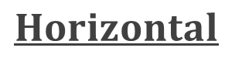

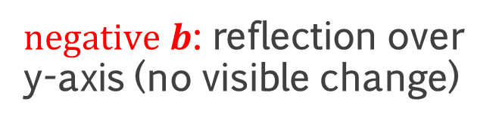
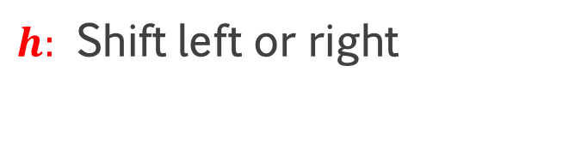
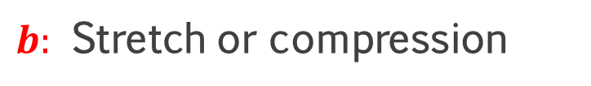
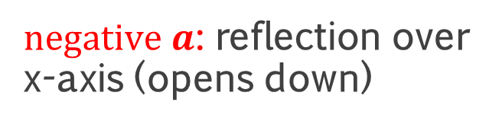
RECALL Transformations
V$ertical$
$$Horizontal$$
$a:$ Stretch or compression
$b:$ Stretch or compression
$negative a$: reflection over x-axis (opens down)
$negative b$: reflection over y-axis (no visible change)
$k:$ Shift up or down
$h:$ Shift left or right

Slide 3
Parameters of Transformations
Recall
Horizontal
Vertical

Slide 4



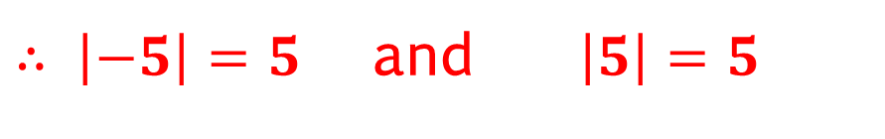
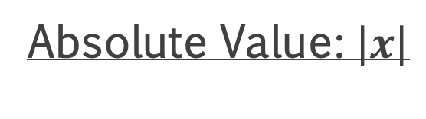
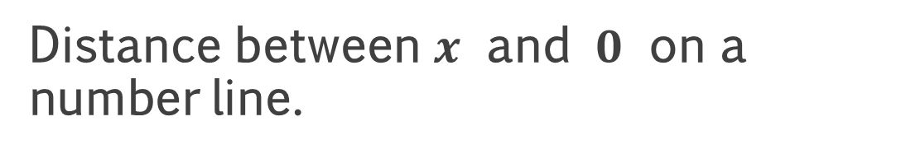
Absolute Value: $f\left(x\right)=\left|x\right|$
Absolute Value: $\left|x\right|$
Distance between $x$ and $0$ on a number line.
An absolute value is always nonnegative.
$∴ \left|−5\right|=5$ and $\left|5\right|=5$

Slide 5



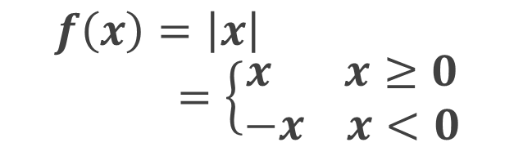

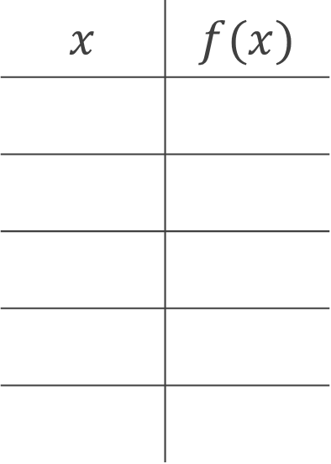






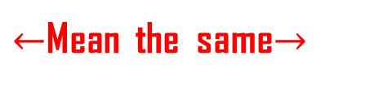




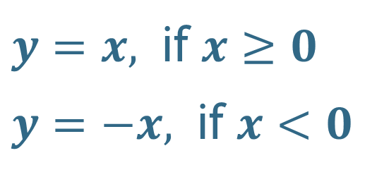



Absolute Value Parent Function: $f\left(x\right)=\left|x\right|$
$$f\left(x\right)=\left|x\right|=\left\{\begin{aligned}x x≥0 \\ −x x<0\end{aligned}\right.$$
$y=x,$ if $x≥0$
$y=−x,$ if $x<0$
$←$Mean the same$→$
$$x$$ | $$f(x)$$
$$6$$
$$−5$$
$$5$$
$$4$$
$$−2$$
$$2$$
$$0$$
$$0$$
$$2$$
$$2$$
$$2$$
$$5$$
$$5$$
$$−4$$
$$−2$$
$$2$$
$$4$$

Slide 6


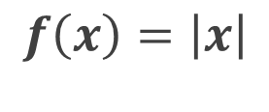











C$haracteristics of Parent Function: f\left(x\right)=\left|x\right|$
$$f\left(x\right)=\left|x\right|$$
$$− Symmetric about the y−axis$$
$$6$$
$$− Domain: \left\{x | −∞<x<∞\right\}$$
$$4$$
$$All ℝ$$
$$− Range: \left\{f(x) | 0≤f(x)<∞\right\}$$
$$2$$
$$All nonnegative ℝ$$
$$− Vertex: \left(0,0\right)$$
$$−4$$
$$−2$$
$$2$$
$$4$$

Slide 7


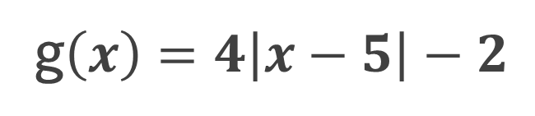





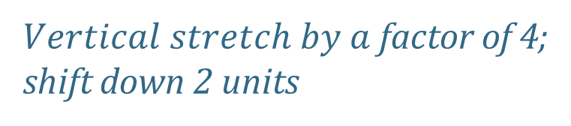

Graphing Absolute Value Functions
A1.
g$\left(x\right)=4\left|x−5\right|−2$
$$Shift right 5 units$$
$$4$$
$$2$$
$Vertical stretch by a$factor of 4;
shift down 2 units
$$−2$$
$$2$$
$$4$$
$− Domain:$ $ℝ$
$$−2$$
$$− Range:$$

Slide 8
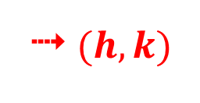

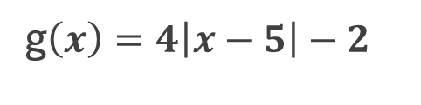





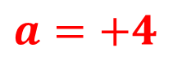



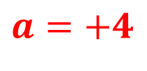

Graphing Absolute Value Functions
A1.
g$\left(x\right)=4\left|x−5\right|−2$
$$4$$
Steps to graph:
$g(x)$
$f(x)$
1. Predict
$(6,2)$
$$2$$
$(4,2)$
2. Shift vertically/horizontally
3. New Vertex:
$$(5,−2)$$
4 $(h,k)$
$$−2$$
$$2$$
$$4$$
$$6$$
$$8$$
4. Open up or down:
$$a=+4$$
4 opens up
$$−2$$
$(5,−2)$
5. Apply stretch/compression:
$$a=+4$$
4 use slope of ±4 on either side of vertex
6. Give 3 coordinates
$$Range:$$
$Domain:$ $ℝ;$

Slide 9
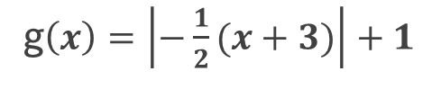
A2.
g$\left(x\right)=\left|−\frac{1}{2}(x+3)\right|+1$
- Horizontal stretch by a factor of 2
- Shift left 3 units
- Reflect over the vertical axis
  (no visible change)
Shift up 1 unit

Slide 10



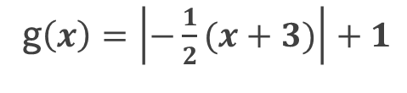



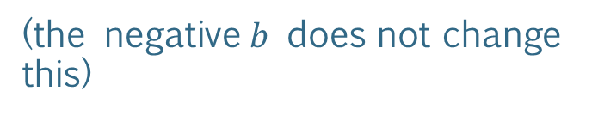

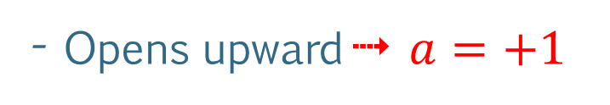





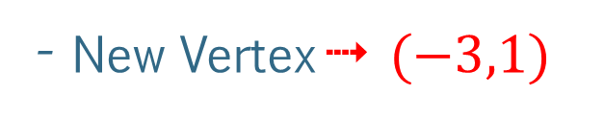







A2.
g$\left(x\right)=\left|−\frac{1}{2}(x+3)\right|+1$
- Shift left 3 units, up 1 unit
- New Vertex 4 $(−3,1)$
$$8$$
- Opens upward 4 $a=+1$
$$6$$
($\text{t}\text{he} \text{negative} b$ does not change this)
$$4$$
$f(x)$
$g(x)$
- Horizontal Stretch 4
$$2$$
apply slope of ± $\frac{1}{2}$ from vertex
$(−5,2)$
$(−1,2)$
$(−3,1)$
Negative b is a reflection over the vertical axis, which is not visible since the graph is symmetric.
$$−8$$
$$−6$$
$$−4$$
$$−2$$
$$2$$
$$4$$
$$−2$$
$$Range:$$
$Domain:$ $ℝ;$

Slide 11



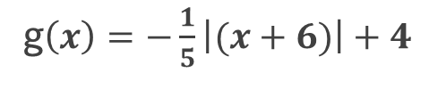




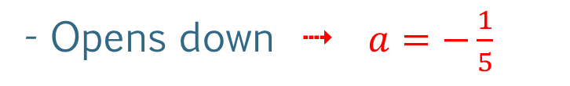










A3.
g$\left(x\right)=−\frac{1}{5}\left|(x+6)\right|+4$
- Shift left 6 units, up 4 units
- New Vertex $\text{4} (−6,4)$
$$8$$
- Opens down 4 $a=−\frac{1}{5}$
$$6$$
- Vertical Compression 4
$(−6,4)$
apply slope of ± $\frac{1}{5}$ from
the vertex
$(−11,3)$
$(−1,3)$
$$4$$
$f(x)$
$g(x)$
$$2$$
$$−10$$
$$−8$$
$$−6$$
$$−4$$
$$−2$$
$$2$$
$$−2$$
$$Range:$$
$Domain:$ $ℝ;$

Slide 12

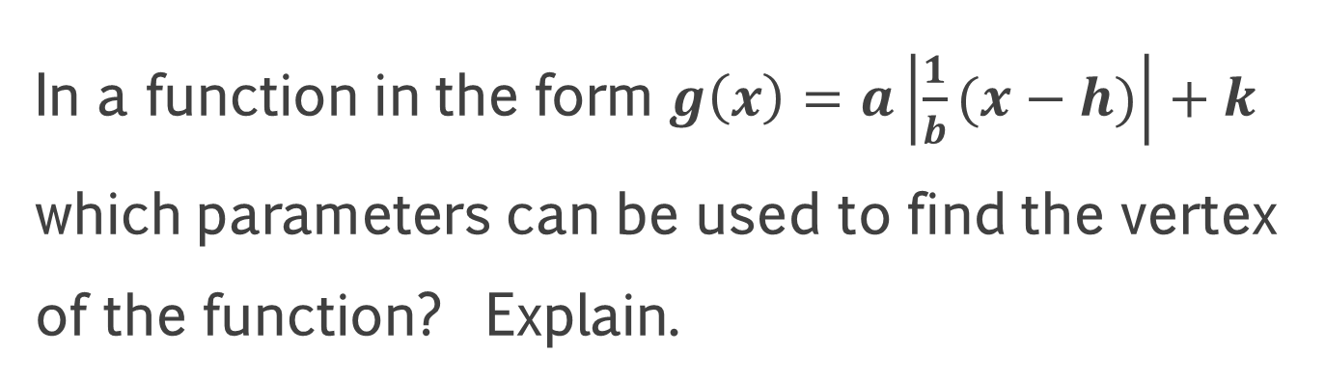
Reflect (not in the textbook)
In a function in the form $g\left(x\right)=a\left|\frac{1}{b}(x−h)\right|+k$
which parameters can be used to find the vertex of the function? Explain.
$h$ and $k$; the vertex of the function, will be at the coordinates $(h, k)$

Slide 13
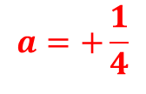


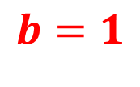






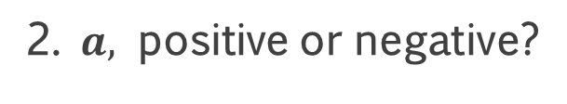





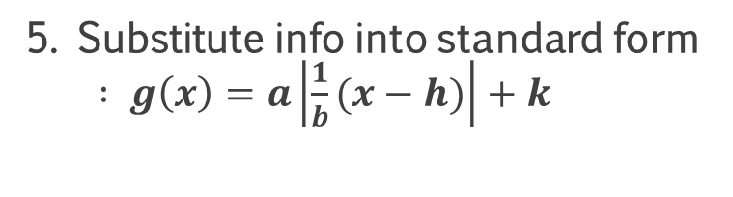


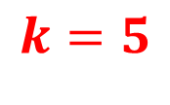






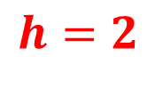
Writing Absolute Value Functions from a Graph
B1.
Steps to graph:
$$10$$
1. Determine Vertex:
$$(2,5)$$
4 $(h,k)$
$$8$$
2. $a,$ positive or negative?
$$Opens up, ∴positive$$
$4$
$1$
$(6,6)$
3. Pick a point on the function:
$$(6,6)$$
$(2,5)$
$$a=\frac{1}{4}$$
4. Determine the slope:
5. Substitute info into standard form $: g\left(x\right)=a\left|\frac{1}{b}(x−h)\right|+k$
$$6$$
$$8$$
$$10$$
$$−2$$
$$a=+\frac{1}{4}$$
$$b=1$$
$$h=2$$
$$k=5$$

Slide 14

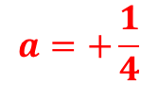
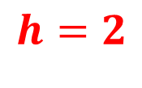



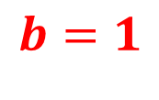
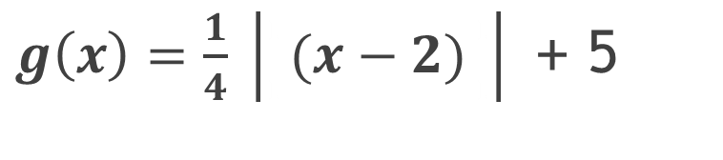

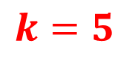
Writing Absolute Value Functions from a Graph
B1.
$$g\left(x\right)=a\left|\frac{1}{b}(x−h)\right|+k$$
$$10$$
$$8$$
$$a=+\frac{1}{4}$$
$$b=1$$
$$h=2$$
$$k=5$$
$4$
$1$
$(6,6)$
$(2,5)$
$g\left(x\right)=\frac{1}{4} \left|\frac{i}{i}(x−2)\frac{i}{i}\right|$ + 5
$$6$$
$$8$$
$$10$$
$$−2$$

Slide 15

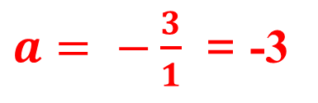
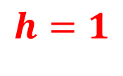

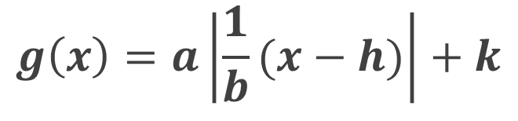

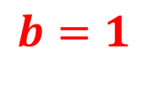
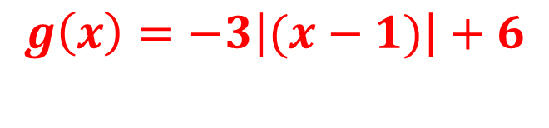


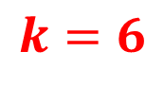
B2.
$$g\left(x\right)=a\left|\frac{1}{b}(x−h)\right|+k$$
$$10$$
$$8$$
$(1,6)$
4$(h,k)$
$a=$ $−\frac{3}{1}$ = -3
$$h=1$$
$3$
$$b=1$$
$$k=6$$
$(2,3)$
$1$
$$g\left(x\right)=−3\left|(x−1)\right|+6$$
$$6$$
$$8$$
$$10$$
$$−2$$

Slide 16














B3.
$$g\left(x\right)=a\left|\frac{1}{b}(x−h)\right|+k$$
$$10$$
$$\frac{2}{3}$$
$$a=+$$
$$b=1$$
$$h=−2$$
$$k=−1$$
$$8$$
$$g\left(x\right)=\frac{2}{3}\left| (x+2)\right|−1$$
$3$
$(1,1)$
$2$
$$6$$
$$8$$
$$10$$
$(−2,−1)$
→$(h,k)$
$$−2$$

Slide 17

Reflect (not in the textbook)
When writing an absolute function from a graph, how can you use the direction in which an absolute value function opens to check your work?
An absolute value function which opens upward will have a positive value for $a$, and an absolute value function which opens downward will have a negative value for $a$.

Slide 18
Assignments:
pp. 56f #6-13
WS 2.1C

Slide 20
TICKET-OUT-THE-DOOR
For the graph of the above function,
what is the vertex?
will the V open up or down?
what will be the slopes of the rays?
what is the domain?
what is the range?

