Slide 1
Mod 2.2:
Solving Absolute Value Equations
Essential Question: How can you solve an absolute value equation?
CASS: A-CED.1 Create equations and inequalities in one variable and use them to solve problems. Also A-REI.3, A-REI.11 MP.6 Precision

Slide 2
Essential Question
How can you solve an absolute value equation?

Slide 3
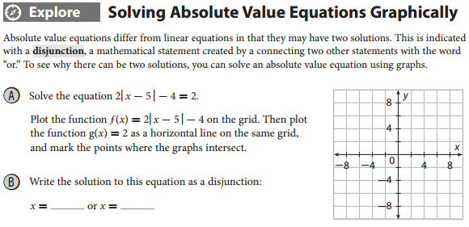
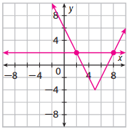
EXPLORE
p. 61
The points are (2,2) and (8,2).

Slide 4
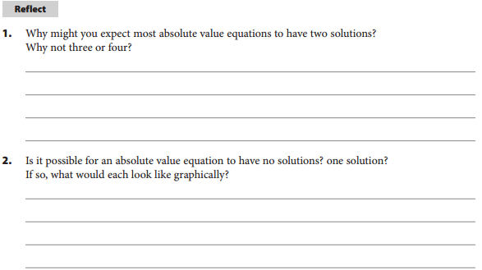
REFLECT
p. 61
If the absolute value expression is not equal to zero, the expression inside an absolute value can be either positive or negative. So, there can be at most two solutions. Looking at this graphically, an absolute value graph can intersect a horizontal line at most two times.
Yes; yes; A graph with the horizontal line entirely below an upward-opening absolute value function, or above a downward-opening absolute value function, will not have points of intersection and the equation will have no solutions. A graph with the horizontal line passing through the vertex will have exactly 1 solution.

Slide 5
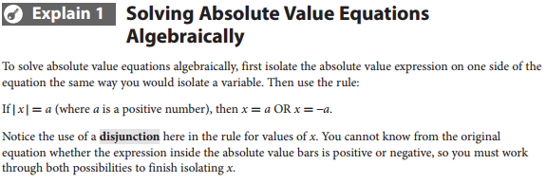
EXPLAIN
p. 62

Slide 6
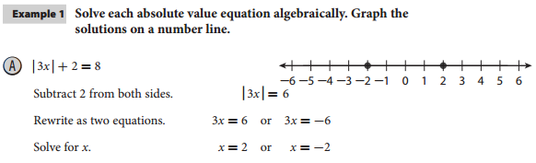
EXAMPLE 1A
p. 62

Slide 7
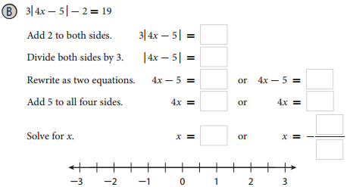
EXAMPLE 1B
p. 62

Slide 8
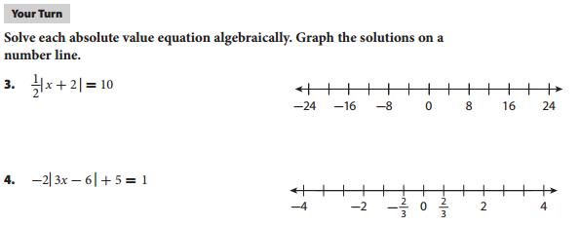



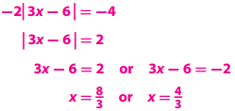
Your Turn
p. 62

Slide 9
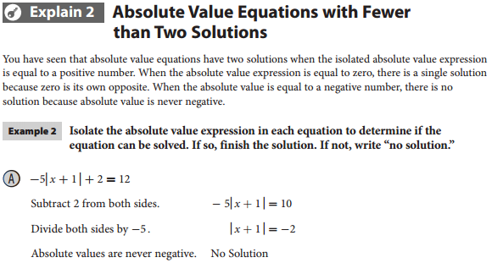
EXPLAIN 2
p. 63
EXAMPLE 2A

Slide 10
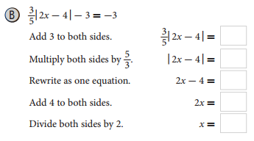
EXAMPLE 2B
p. 63

Slide 11
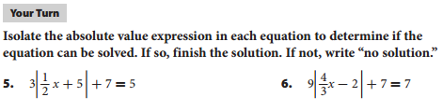
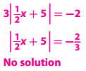
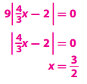
Your Turn
p. 63

Slide 12
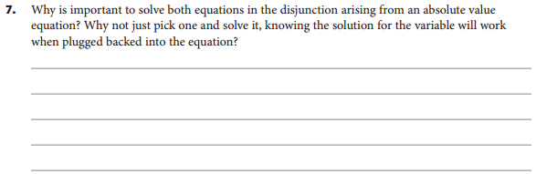
ELABORATE
p. 64
The solution to a mathematical equation is not simply any value of the variable that makes the equation true. Supplying only one value that works in the equation implies that it is the only value that works, which is incorrect.

Slide 13
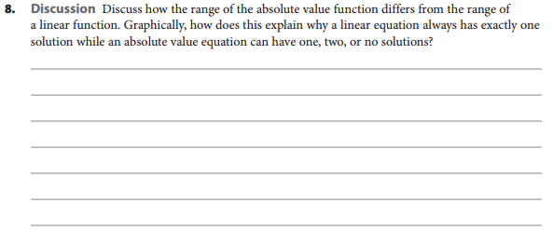
ELABORATE
p. 64
The range of a non-constant linear function is all real numbers. The range of an absolute value function is y > k if the function opens upward and y < k if the function opens downward. Because the graph of a linear function is a line, a horizontal line will intersect it only once. Because the graph of an absolute value function is a “V”, a horizontal line can intersect it once, twice, or not at all.

Slide 14
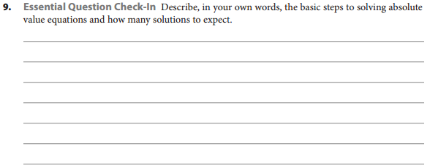
ELABORATE
p. 64
Isolate the absolute value expression. If the absolute value expression is equal to a positive number, solve for both the positive and negative case. If the absolute value expression is equal to zero, the remove the absolute value bars and solve the equation. If the absolute value expression is equal to a negative number, then there is no solution.

Slide 15
Revisit Essential Question
How can you solve an absolute value equation?
Isolate the absolute value expression, then write two related equations with a disjunction, also known as an “or” statement.

Slide 17
ASSIGNMENTS
pp. 65ff #1-16

