Slide 1
Mod 2.3:
Solving Absolute Value Inequalities
Essential Question: What are two ways to solve an absolute value inequality?
CASS: A-CED.1 Create equations and inequalities in one variable and use them to solve problems. Also A-REI.3, F-IF.7b MP.6 Precision

Slide 2
Essential Question
What are two ways to solve an absolute value inequality?

Slide 3
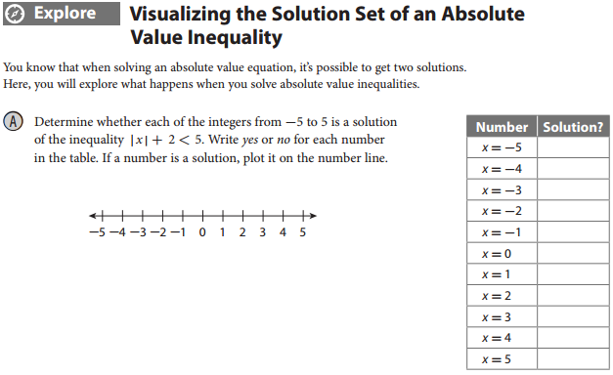
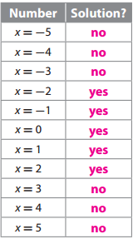

EXPLORE
p. 71

Slide 4
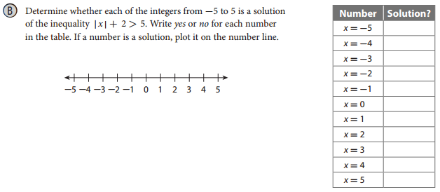
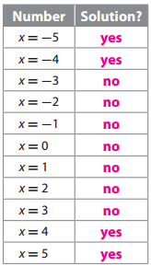

EXPLORE
p. 71

Slide 5
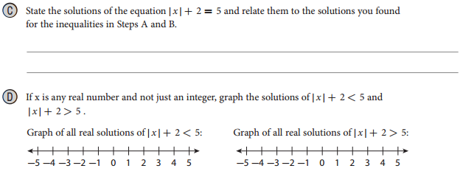
EXPLORE
p. 72
The solutions are -3 and 3. These are the only numbers that are not solutions of the inequalities |x| + 2 < 5 and |x| + 2 > 5.

Slide 6
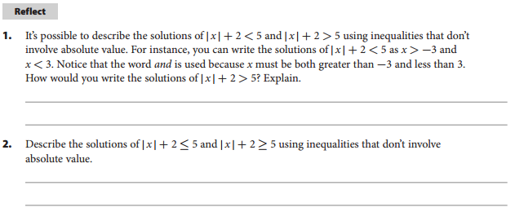
REFLECT
p. 72
Write the solutions of |x| + 2 > 5 as x < -3 or x > 3. Use the word or because x must be either less than -3 or greater than 3; it can’t be both.
The solutions of |x| + 2 ≤ 5 are the values of x for which x ≥ -3 and x ≤ 3. The solutions of |x| + 2 ≥ 5 are the values of x for which x ≤ -3 or x ≥ 3.

Slide 7
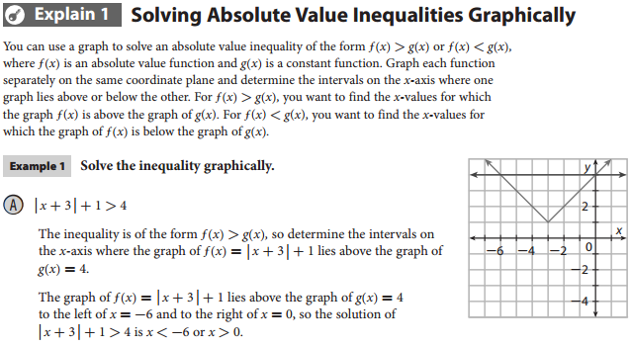
EXPLAIN 1
p. 72
EXAMPLE 1A

Slide 8
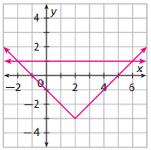
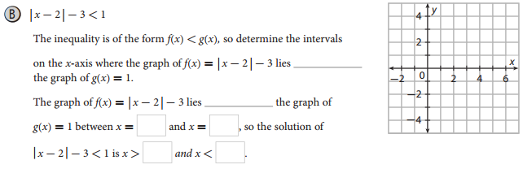
EXAMPLE 1B
below
below
p. 73

Slide 9
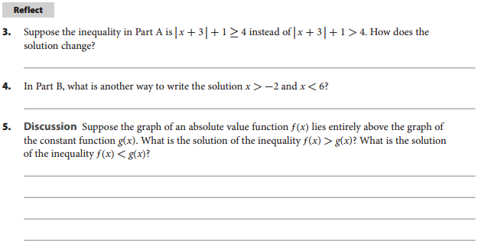
REFLECT
p. 73
The solution now includes the endpoints of the interval: x ≤ -6 or x ≥ 0.
-2 < x < 6
The solution of f(x) > g(x) is all real numbers, because every point on the graph of f(x) is above the corresponding point on the graph of g(x). The solution of f(x) < g(x) is no real number, because no point on the graph of f(x) is below the corresponding point on the graph of g(x).

Slide 10

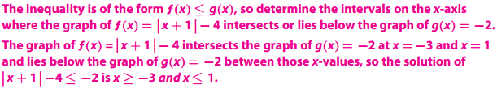
If
Your Turn
p. 73

Slide 11
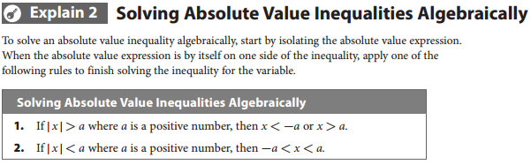
EXPLAIN 2
p. 73

Slide 12

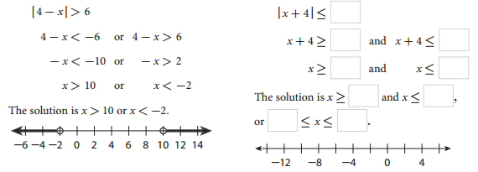

EXAMPLE 2
p. 74

Slide 13
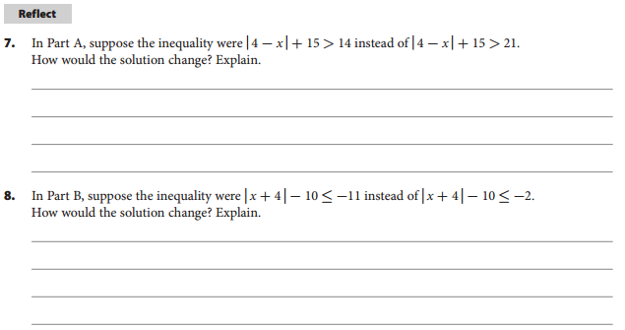
REFLECT
p. 74
The first step in solving would be to subtract 15 from both sides and get |4 – x| > -1. At this point, the solving process can stop, because the absolute value of every number is greater than -1. So, the solution is all real numbers.
The first step would be to add 10 to both sides and get |x + 4| ≤ -1. At this point, the solving process can stop, because there are no real numbers whose absolute value is less than or equal to -1. So, there is no solution.

Slide 14
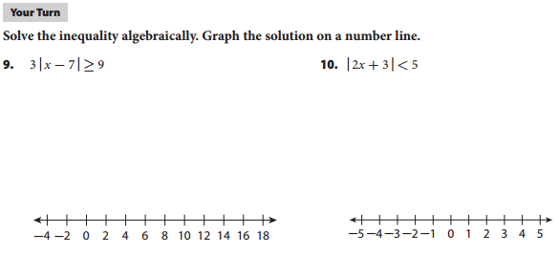
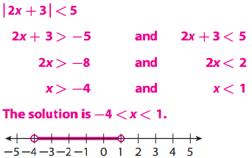
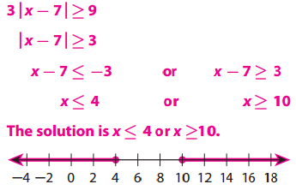
Your Turn
p. 75

Slide 15
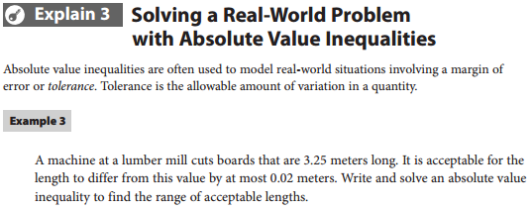
EXPLAIN 3
p. 75
EXAMPLE 3

Slide 16
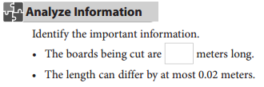
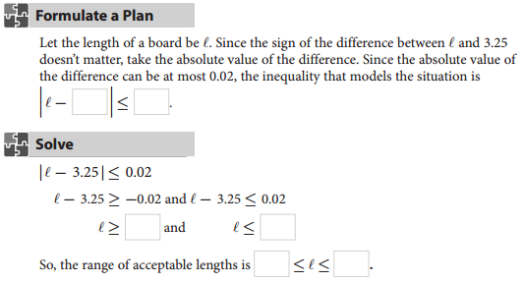
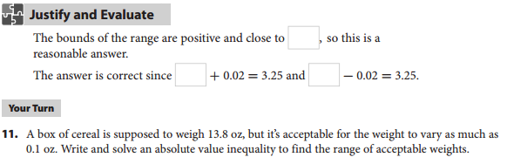
pp. 75-76

Slide 17
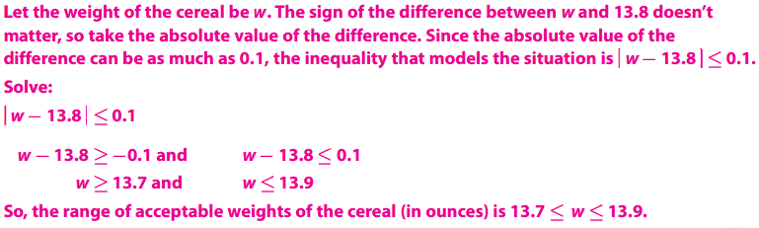
Your Turn
p. 76

Slide 18
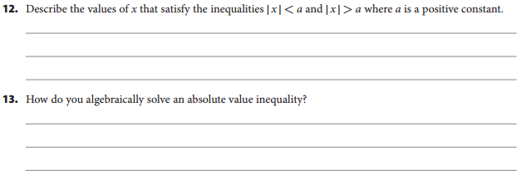
p. 76
ELABORATE
For |x| < a, the solutions are values of x between -a and a. For |x| > a, the solutions are the values of x beyond -a and a (that is, the values of x less than -a or the values of x greater than a).
Isolate the absolute value expression. Then rewrite the inequality as a compound inequality that uses either and or or and that doesn’t involve absolute value. Finish solving for the variable.

Slide 19
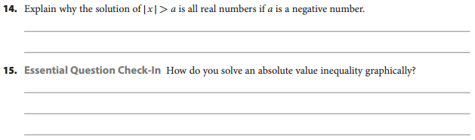
ELABORATE
p. 76
Since the absolute value of any number is always nonnegative, it is always greater than any negative number. So, all real numbers satisfy the inequality.
Treat each side of the inequality as a function and graph the two functions. Use the inequality symbol to determine the intervals on the x-axis where one graph lies above or below the other.

Slide 20
Essential Question
What are two ways to solve an absolute value inequality?
You can solve an absolute value inequality graphically or algebraically.
For a graphical solution, treat each side of the inequality as a function and graph the two functions. Use the inequality symbol to determine the intervals on the x-axis where one graph lies above or below the other. For an algebraic solution, isolate the absolute value expression and rewrite the inequality as a compound inequality that doesn’t involve absolute value so that you can finish solving the inequality.

Slide 21
ASSIGNMENTS
pp. 77ff #1-21

