Slide 1
Mod 3.1: Understanding Rational Exponents and Radicals
Essential Question: How are radicals and rational exponents related?
CASS: N-RN.1 Explain how the definition of the meaning of rational exponents follows from extending the properties of integer exponents to those values, allowing for a notation for radicals in terms of rational exponents. Also N-RN.2

Slide 2
Essential Question
How are radicals and rational exponents related?

Slide 3




Review
Simplify:
$$\sqrt{{(x+2)}^{2}}$$
$$\sqrt{125}$$
$$\sqrt[3]{125}$$
$$\sqrt[4]{16}$$

Slide 5
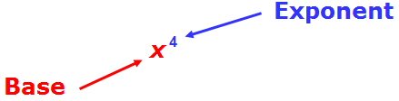
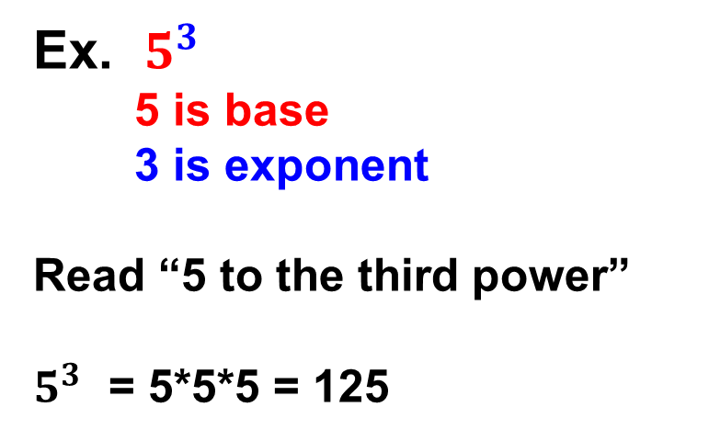
What is exponent notation?
Ex. $5^{3}$
5 is base
3 is exponent
Read “5 to the third power”
$5^{3}$ = 5*5*5 = 125

Slide 6
_______________
n
____________
When n = 2, the radical is a square root and the index 2 is usually not shown.

Slide 7
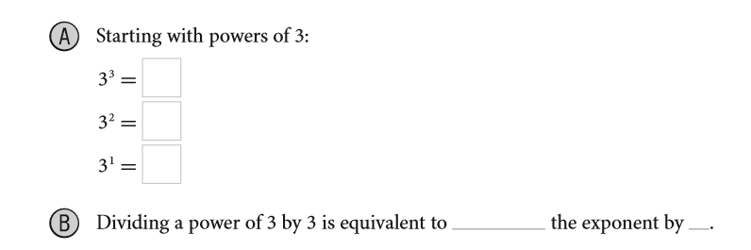
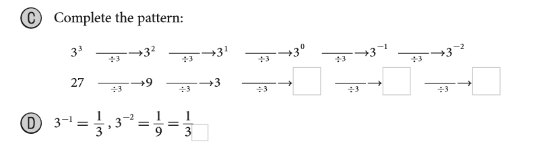
EXPLORE 1
Understanding Integer Exponents (p. 97)
1

Slide 8
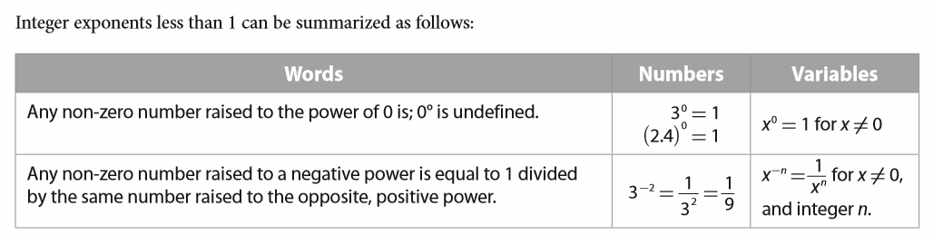
EXPLORE 1
Understanding Integer Exponents
1

Slide 9


Exponent Rule
Power of a Power Property
$\text{(}{x^{m})}^{n}$ = $x^{mn}$ $\text{(}{x^{a}y^{b})}^{n}$ = $x^{an}y^{bn}$

Slide 10
Radical
n
When n = 2, the radical is a square root and the index 2 is usually not shown.

Slide 11
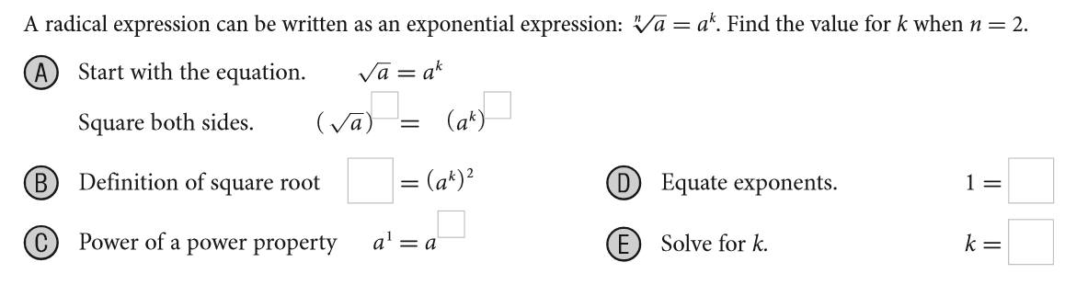
EXPLORE 2
Exploring Rational Exponents (p. 98)

Slide 12






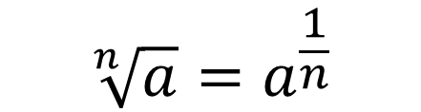
EXPLAIN 2
Simplifying Numerical Expressions with Rational Exponents (p. 99).
An exponent in the form of a fraction is a rational exponent.
$${\sqrt[n]{a}=a}^{\frac{1}{n}}$$
For an integer n greater than 1,
Power of a Power Property to define $a^{\frac{m}{n}}$ for any positive integer m.

Slide 13


EXPLAIN 1
Find the root and simplify the expression (page 98).

Slide 14
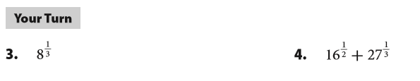
Your Turn
p. 99

Slide 15

EXAMPLE 2
Simplify expressions with fractional exponents (p. 99).

Slide 16
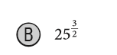
EXAMPLE 2
Simplify expressions with fractional exponents (p. 99).

Slide 17


Your Turn
p. 100

Slide 18
Revisit Essential Question
How are radicals and rational exponents related?

