Slide 1
Warm-Ups
Many numbers can be re-written as the ratio of two integers. For example, . Can the following numbers can be re-written as the ratio of two integers?

Slide 2
Mod 3.2:
Simplifying Expressions with Rational Exponents and Radicals
Essential Question: How can you write a radical expression as an expression with a rational exponent?
CASS: N-RN.2 Rewrite expressions involving radicals and rational exponents using the properties of exponents. Also N-RN.3, A-SSE.1b

Slide 3
Essential Question
How can you write a radical expression as an expression with a rational exponent?

Slide 4
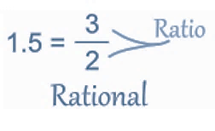
EXPLORE 1
Will the sum of two irrational numbers always be rational, always be irrational, or can it be either?
Rational Numbers
A Rational Number is a real number that can be written as a ratio of two numbers.
Examples:
1/2 is a rational number (1 divided by 2, or the ratio of 1 to 2)
0.75 is a rational number (3/4)
1 is a rational number (1/1)
2 is a rational number (2/1)
2.12 is a rational number (212/100)
−6.6 is a rational number (−66/10)

Slide 5
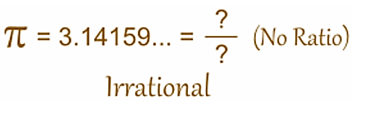
EXPLORE 1
Will the sum of two irrational numbers always be rational, always be irrational, or can it be either? What about the product of two irrational numbers?
Irrational Number
A real number that can NOT be made by dividing two integers.
The decimal goes on forever without repeating.
Example: Pi is an irrational number.

Slide 6
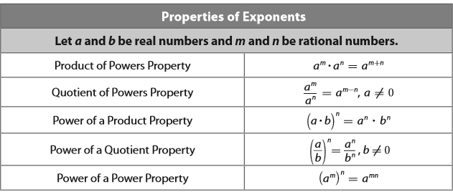
EXPLAIN 1
p. 110

Slide 7




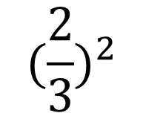

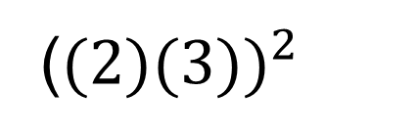
EXPLAIN 1
Simplify each expression.
$${(2}^{2})(2^{3})$$
$$\frac{2^{3}}{2^{2}}$$
(${(2)(3))}^{2}$
$${(\frac{2}{3})}^{2}$$
$${{(2}^{3})}^{2}$$

Slide 8
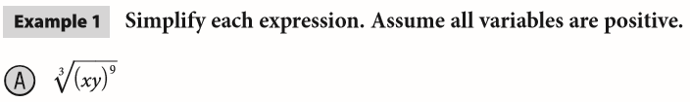

EXPLAIN 1
p. 110

Slide 9
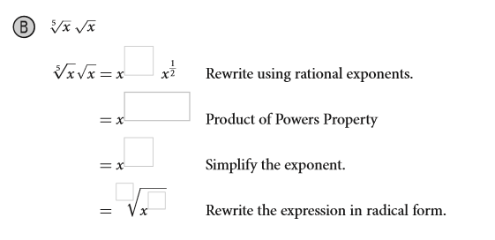




EXPLAIN 1
p. 110

Slide 10


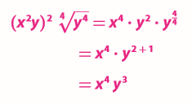
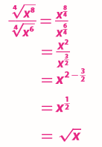
Your Turn
Simplify each expression. Assume all variables are positive (p. 111).

Slide 11

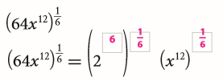
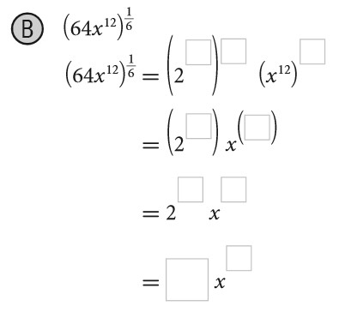







EXPLAIN 2
p. 111
Simplify each expression. Assume all variables are positive.

Slide 12


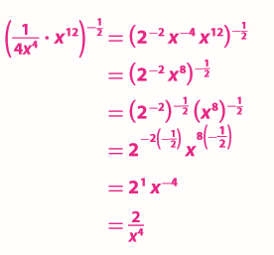
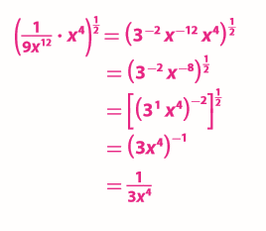
Your Turn
Simplify each expression. Assume all variables are positive (p. 112).

Slide 13
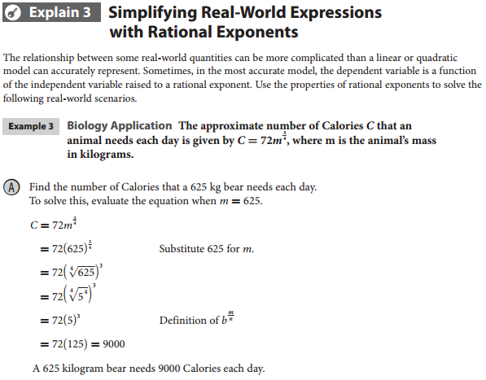
p. 112

Slide 14
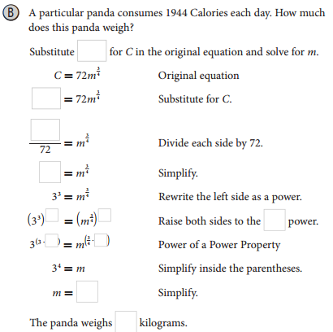

p. 113

Slide 15






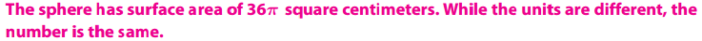
p. 114

Slide 16
Revisit Essential Question
How can you write a radical expression as an expression with a rational exponent?
You can write a radical expression as an expression with a rational exponent by extending the properties of integer exponents to rational exponents.

Slide 17
ASSIGNMENTS
WS 3.2 A/B
pp. 115 #3-22

