Slide 1
Warm-Ups
Next to each prefix, write its meaning.
anti
auto
bi
circum
co
de
di
extra
hemi
inter
intra
macro
meta
mis
mono
multi
neo
penta
poly
post
pre
pro
proto
pseudo
re
retro
semi
sub
super
trans
tri
ultra
uni

Slide 2
Mod 4.1:
Understanding Polynomial Expressions
Essential Question: What are polynomial expressions, and how do you simplify them?
CASS: A-SSE.1a Interpret parts of an expression, such as terms, factors, and coefficients. Also A-SSE.1b, A-SSE.2, A-APR.1, A-CED.1

Slide 3
Essential Question
What are polynomial expressions, and
how do you simplify them?
A polynomial expression is a monomial or a sum of monomials. You simplify them by combining like terms.

Slide 4
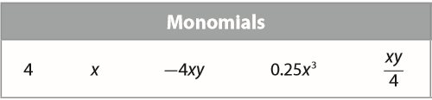
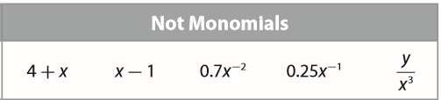
EXPLORE 1
A monomial is an expression consisting of a number, variable, or product of numbers and variables that have whole number exponents.

Slide 5
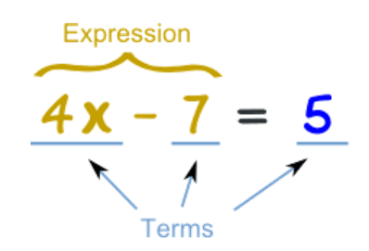
EXPLORE 1
Terms are separated by + or − signs.

Slide 6
Polynomial Properties:
NO variables in the denominator
NO negative exponents for a variable
NO variables under a root ( √ )
NO fractional exponents for a variable

Slide 7
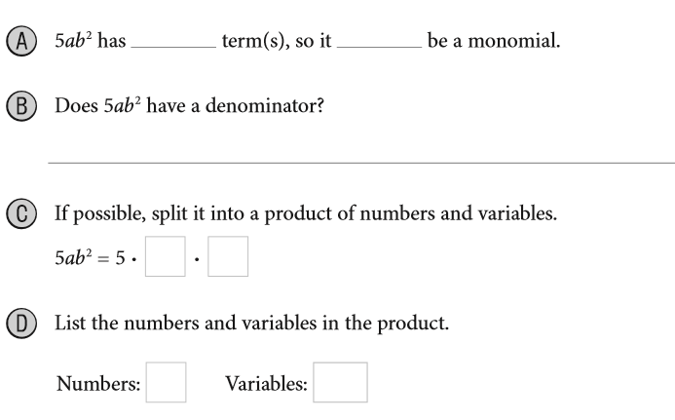



EXPLORE
p. 127

Slide 8
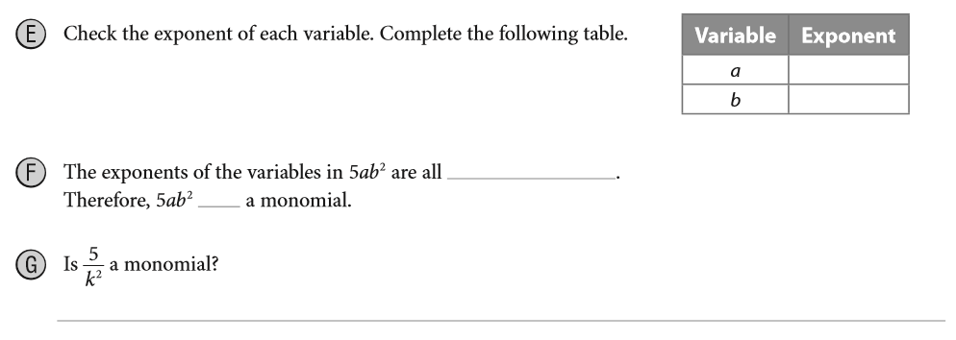
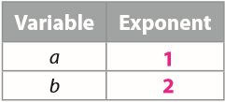


EXPLORE
p. 127

Slide 9
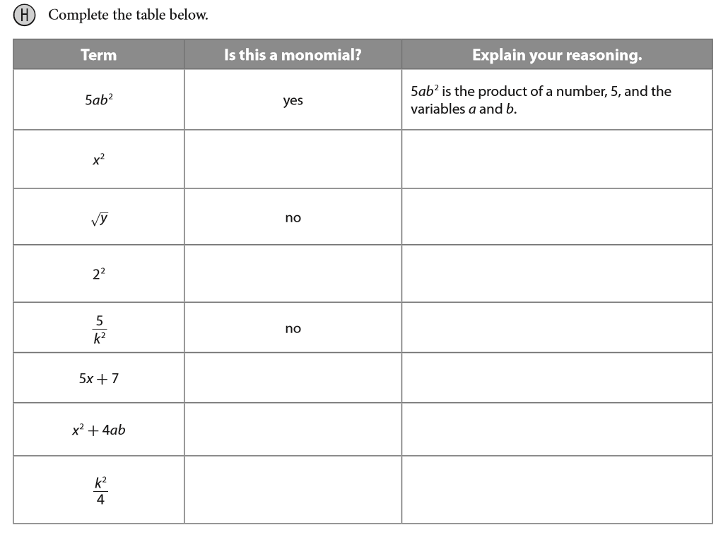






p. 128

Slide 10
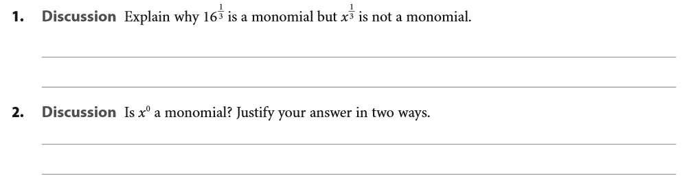

REFLECT
p. 128

Slide 11
EXPLAIN 1
p. 128
A polynomial can be a monomial or a sum of monomials.
Binomial
Binomial
Trinomial

Slide 12
Degree
p. 128
The degree of a term is the sum of the exponents of the variables. The degree of a polynomial is the highest degree of the terms.
The degree of term 5x y³ is 7.
The degree of term -2x²y is 6.
The degree of term 3 is 0.
The degree of the polynomial is 7.

Slide 13


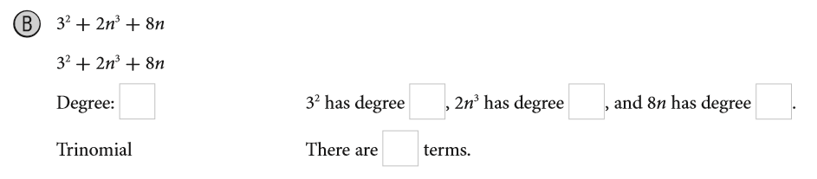
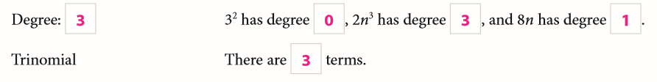
EXAMPLE 1
p. 129

Slide 14

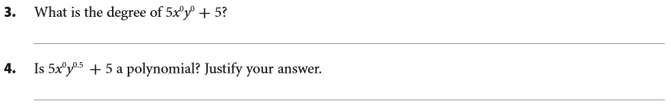
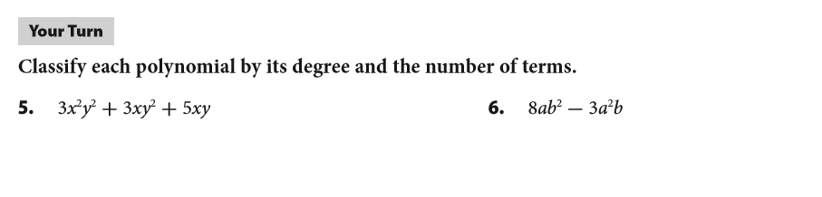


REFLECT
p. 129

Slide 15
Definition
A coefficient is the number in front of each term
3x² is a term, it has a coefficient of 3.
The coefficient of the term 2x is 2.
The -5 is called a constant, because there are no variables attached. Its coefficient is -5.

Slide 16
Definition
EXPLAIN 2
p. 129
The term with the highest degree is called the leading term. The coefficient of the leading term is called the leading coefficient.
Leading term is 4c³ and the leading coefficient = 4.

Slide 17
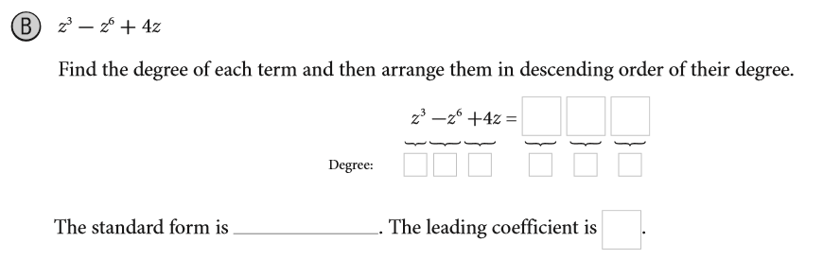
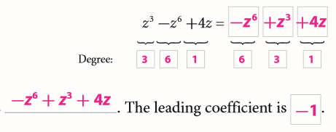
EXAMPLE 2
p. 129
The standard form of a polynomial containing only one variable is written with the terms in order of decreasing degree.
The first term will have the greatest degree, the next term will have the next greatest degree, and so on, until the final term, which will have the lowest degree.

Slide 18
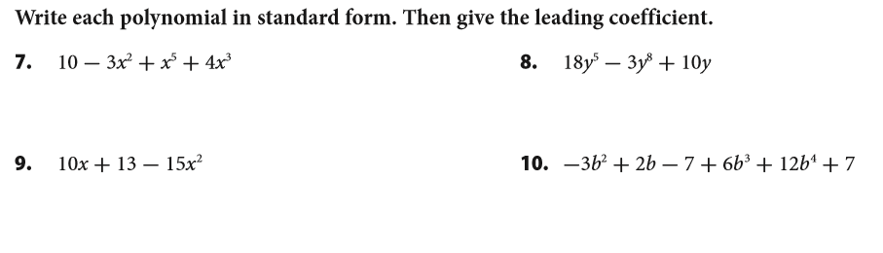




Your Turn
p. 130

Slide 19
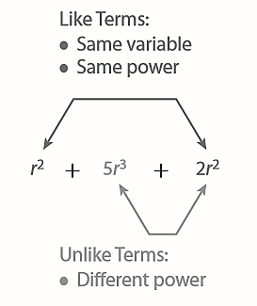
EXPLAIN 3
p. 130
Polynomials are simplified by combining like terms.
Like terms are monomials that have the same variables raised to the same powers.
Unlike terms have different powers.

Slide 20
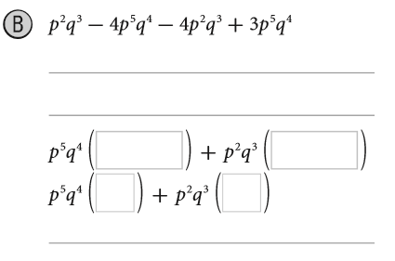

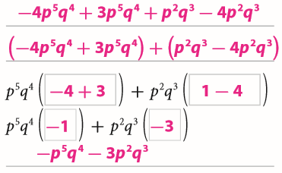
EXAMPLE 3
p. 131

Slide 21
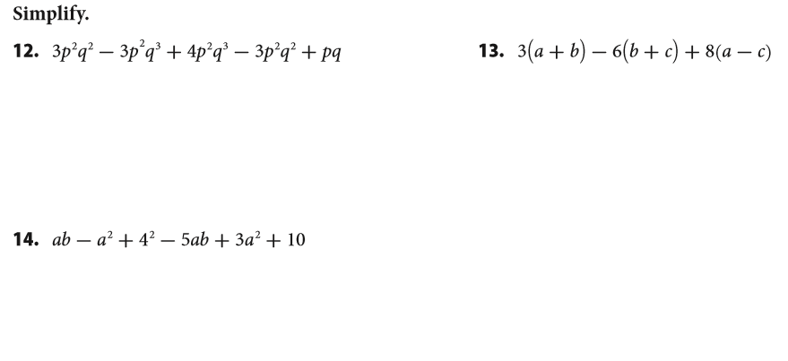



Your Turn
p. 132

Slide 22
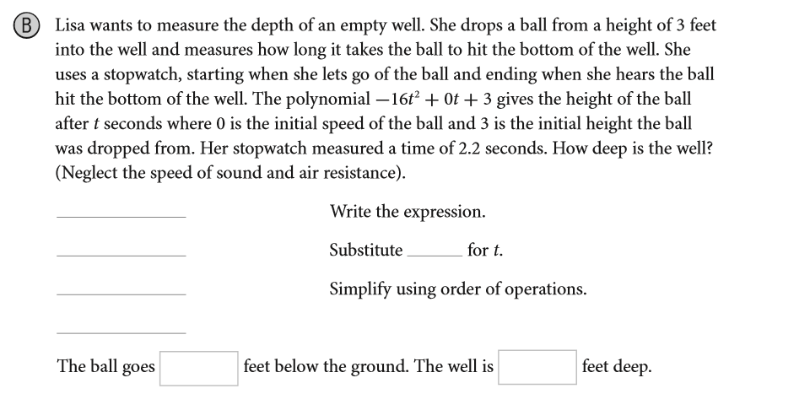


EXPLAIN 4
p. 132

Slide 23
Essential Question
What are polynomial expressions, and
how do you simplify them?
A polynomial expression is a monomial or a sum of monomials. You simplify them by combining like terms.

Slide 24
ASSIGNMENTS
WS 4.1 A/B
pp. 134 #1-17

