Slide 1
Warm-Up
Given two three-digit numbers abb and abc, find the value for digits a, b, c, d, and e.
Here are the clues:
  a + b = c
  abc + abb = ddd

Slide 2
Mod 4.2:
Adding Polynomial Expressions
Essential Question: How do you add polynomials?
CASS: A-APR.1 Understand that polynomials form a system analogous to the integers, namely, they are closed under the operations of addition, subtraction, and multiplication; add, subtract, and multiply polynomials. Also A-SSE.1, A-CED.1

Slide 3
Essential Question
How do you subtract polynomials?

Slide 4
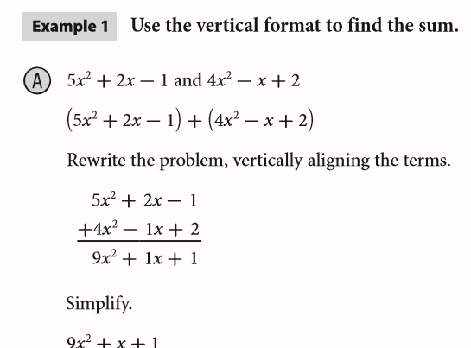
EXPLAIN 1
p. 140

Slide 5
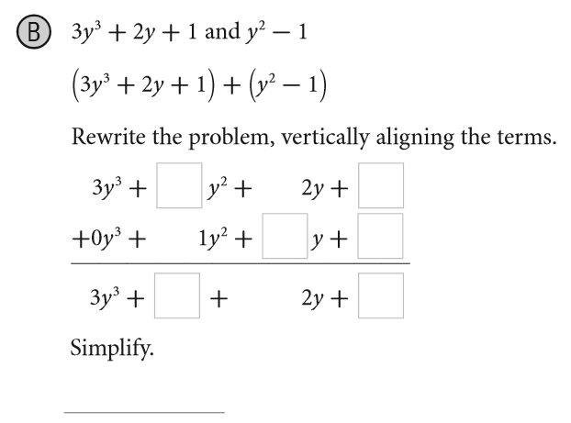
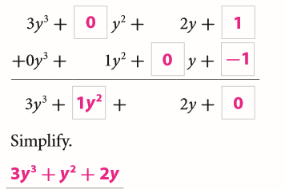
EXPLAIN 1
p. 140

Slide 6
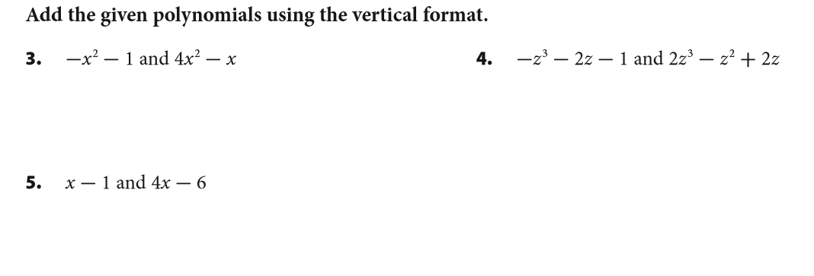

Your Turn
p. 141

Slide 7
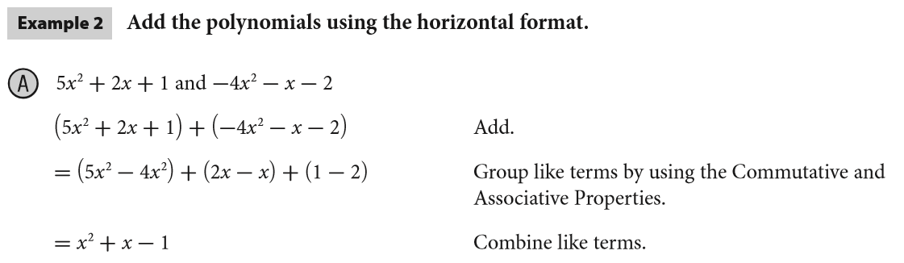
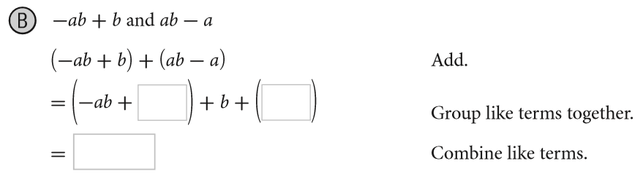
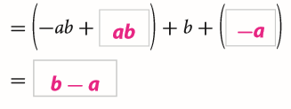
EXPLAIN 2
p. 142

Slide 8
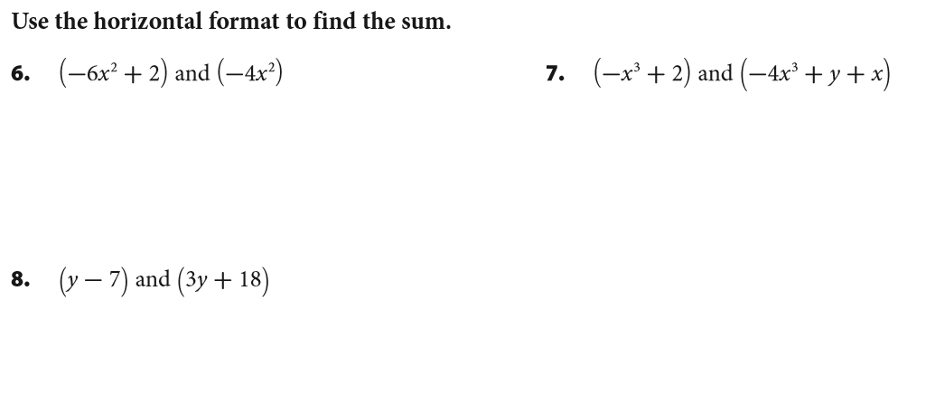



Your Turn
p. 142

Slide 9
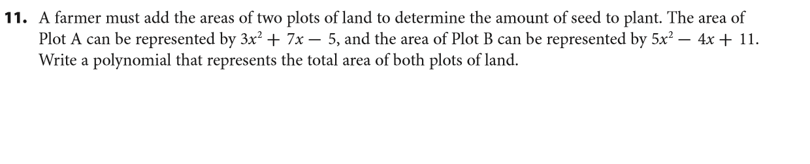
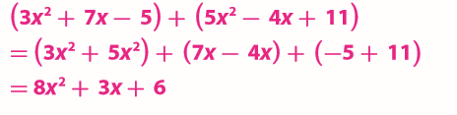
Your Turn
p. 144

Slide 10
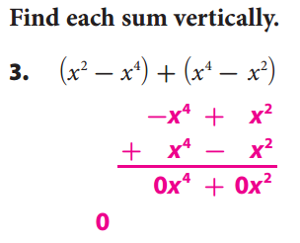
WE DO
p. 145

Slide 11
Revisit Essential Question
How do you add polynomials?
Combine the like terms of the polynomials.

Slide 12
ASSIGNMENTS
WS 4.2 A/B
pp. 145 #3-15 odds

