Slide 1
Warm-Up
Given two three-digit numbers abb and abc, find the value for digits a, b, c, d, and e.
Here are the clues:
  a + b = c
  abc + abb = ddd

Slide 3
Mod 4.3:
Subtracting Polynomial Expressions
Essential Question: How do you subtract polynomials?
CASS: A-APR.1 Understand that polynomials form a system analogous to the integers, namely, they are closed under the operations of addition, subtraction, and multiplication; add, subtract, and multiply polynomials. Also A-SSE.1, A-CED.1

Slide 4
Revisit Essential Question
How do you subtract polynomials?

Slide 5
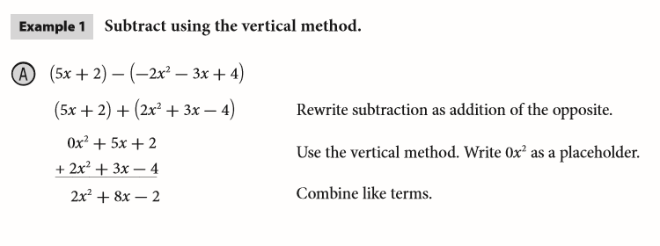
EXPLAIN 1
p. 152
To subtract polynomials, rewrite the subtraction as addition of the opposite.

Slide 6
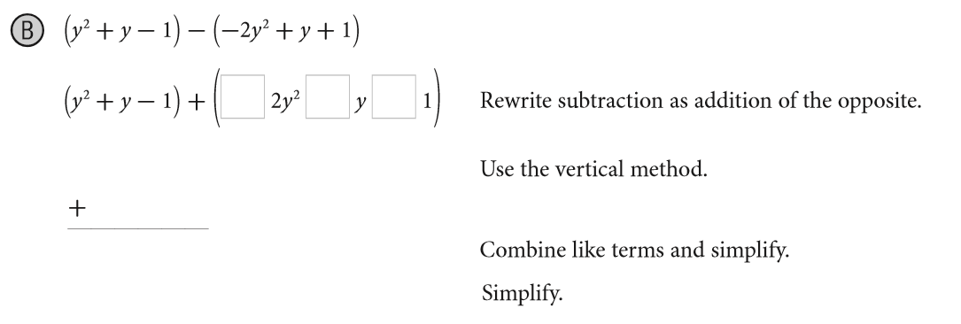
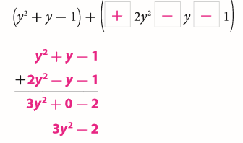
EXPLAIN 1
p. 152
To subtract polynomials, rewrite the subtraction as addition of the opposite.

Slide 7
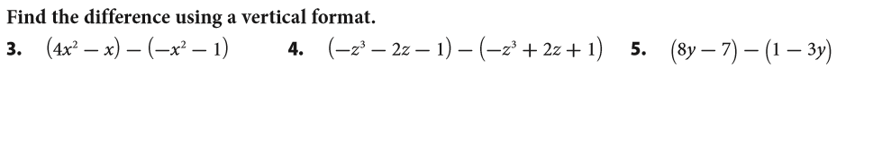

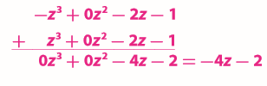

Your Turn
p. 153

Slide 8
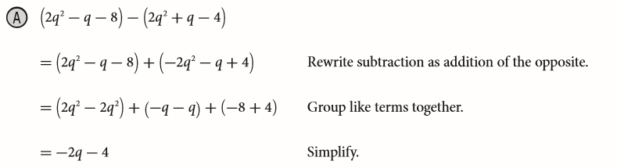
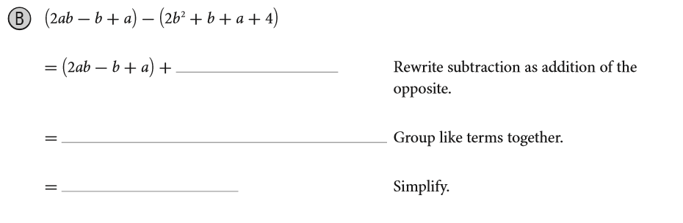
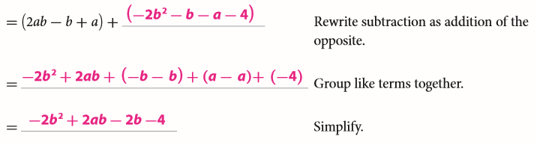
EXPLAIN 2
p. 153

Slide 9
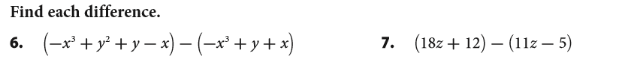

Your Turn
p. 154

Slide 10
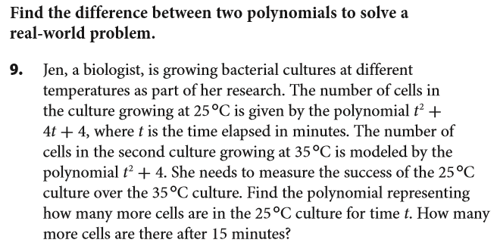


Your Turn
p. 155

Slide 11
Revisit Essential Question
How do you subtract polynomials?
Subtract polynomials by adding the opposite of the polynomial that is being subtracted.

Slide 12
ASSIGNMENTS
WS 4.3 A/B
pp. 157 #3-15 odds

